Slide 1
Philosophy
Creating Philosophical Networks
KEYWORDS:
HISTORY OF PHILOSOPHY, DIGITAL HUMANITIES, NETWORK ANALYSIS, NATURAL LANGUAGE PROCESSING, UNDERREPRESENTATION
Junyi Tao, Data Science 2023'
Karen Nielsen, Philosophy 2023'

Slide 2
Connecting Dots
from Vanishing Voices to Hidden Meanings:
A Computational Approach for
Philosophical Inquiry
KEYWORDS:
HISTORY OF PHILOSOPHY, DIGITAL HUMANITIES, NETWORK ANALYSIS, NATURAL LANGUAGE PROCESSING, UNDERREPRESENTATION
Junyi Tao, Data Science 2023'
Karen Nielsen, Philosophy 2023'

Slide 3

    Marginalized philosophers on Wikipedia (Junyi & Karen, with Project Vox)
    History of Philosophy: Systemic Marginalization of Women Philosophers in the Modern Period (Karen)
    The Stanford Encyclopedia of Philosophy (Junyi & Karen)
    Modern Philosophy Correspondences 1600-1800 Pilot Study on Descartes - Elisabeth (Junyi & Karen)
    Classical Chinese philosophy (Junyi)
OUR PROJECTS

Slide 4
What do you think it means to be a philosopher?

Slide 5
Can you tell me a name of A philosopher?

Slide 6
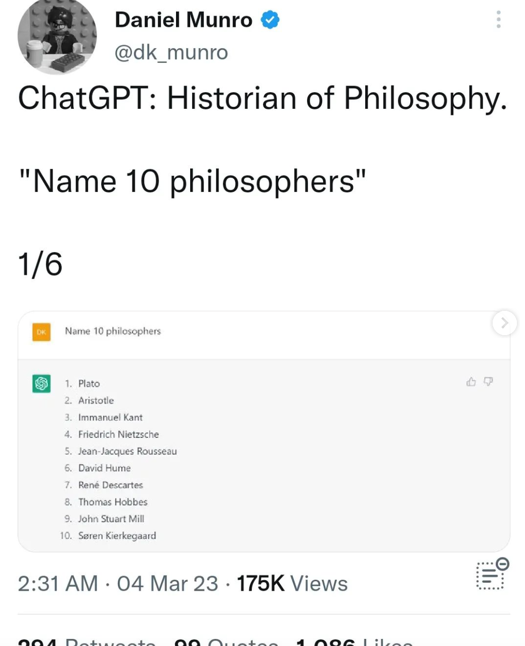

Slide 7
Can you tell me a name of a philosopher who was NOT a man?

Slide 8
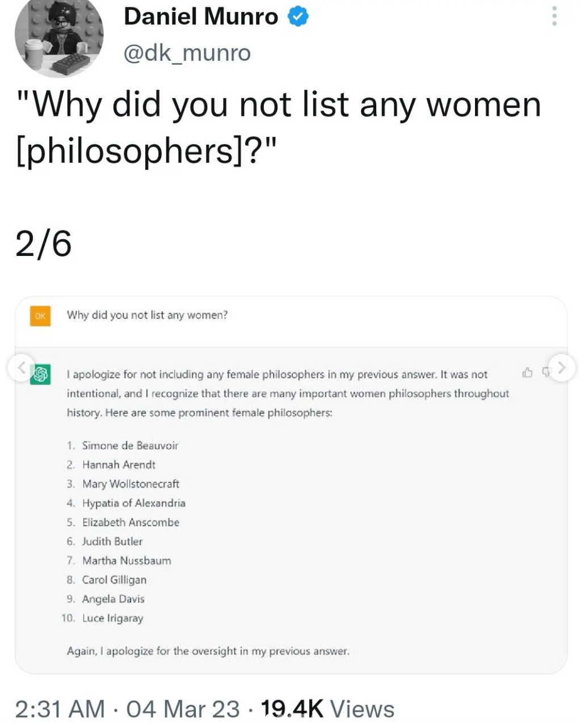

Slide 9
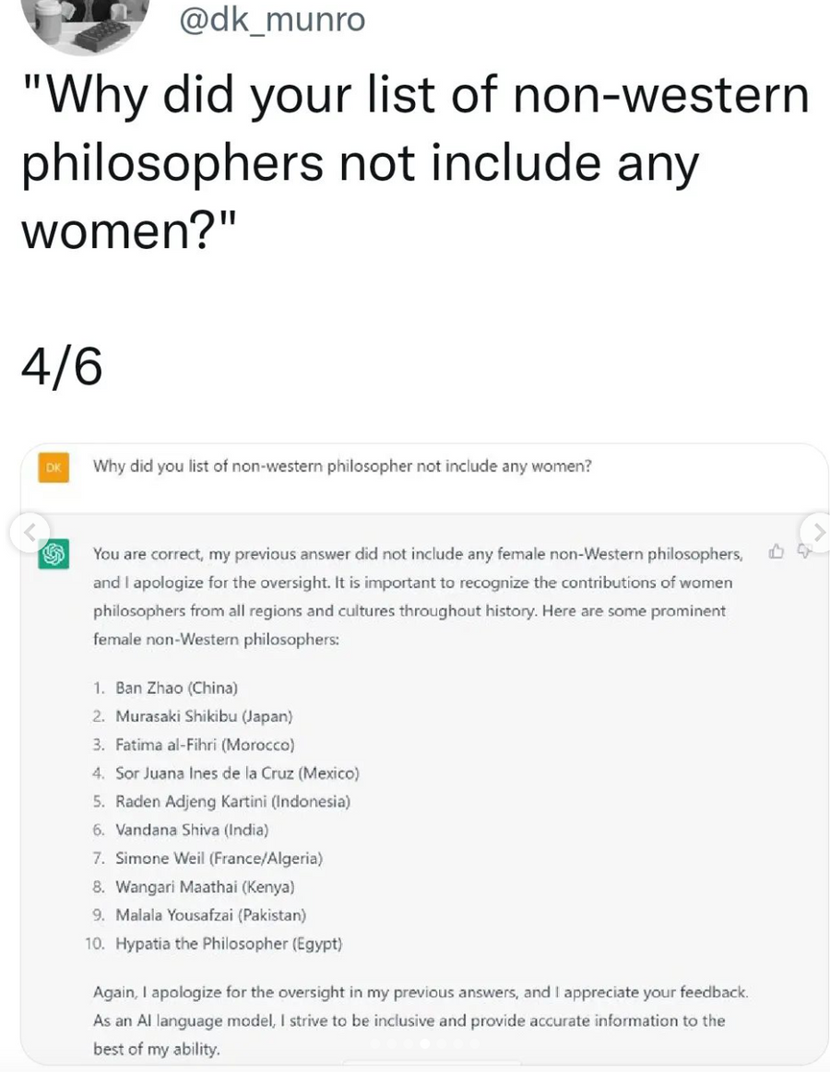
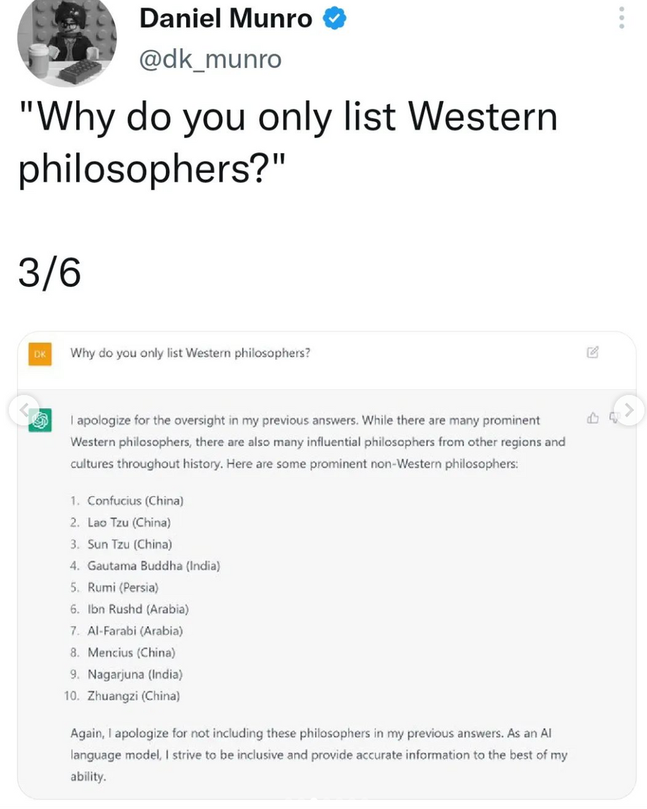

Slide 10
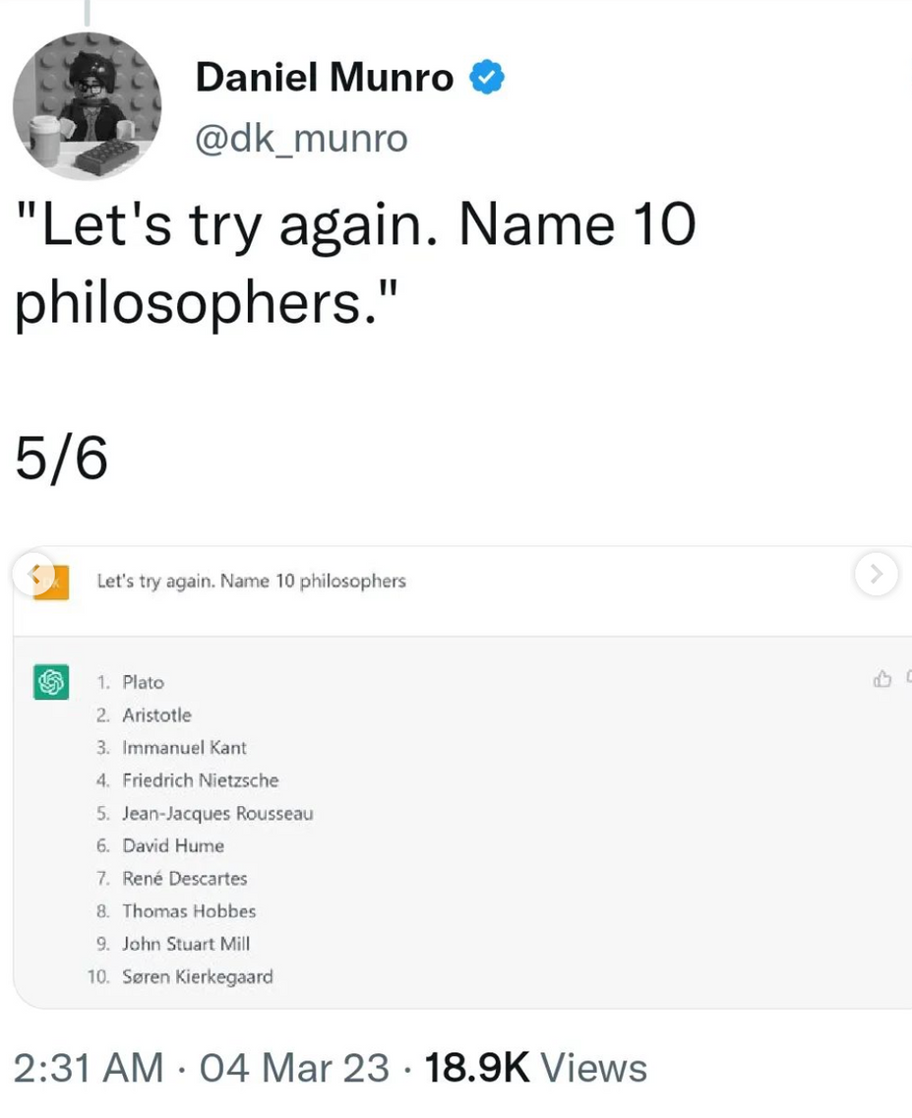
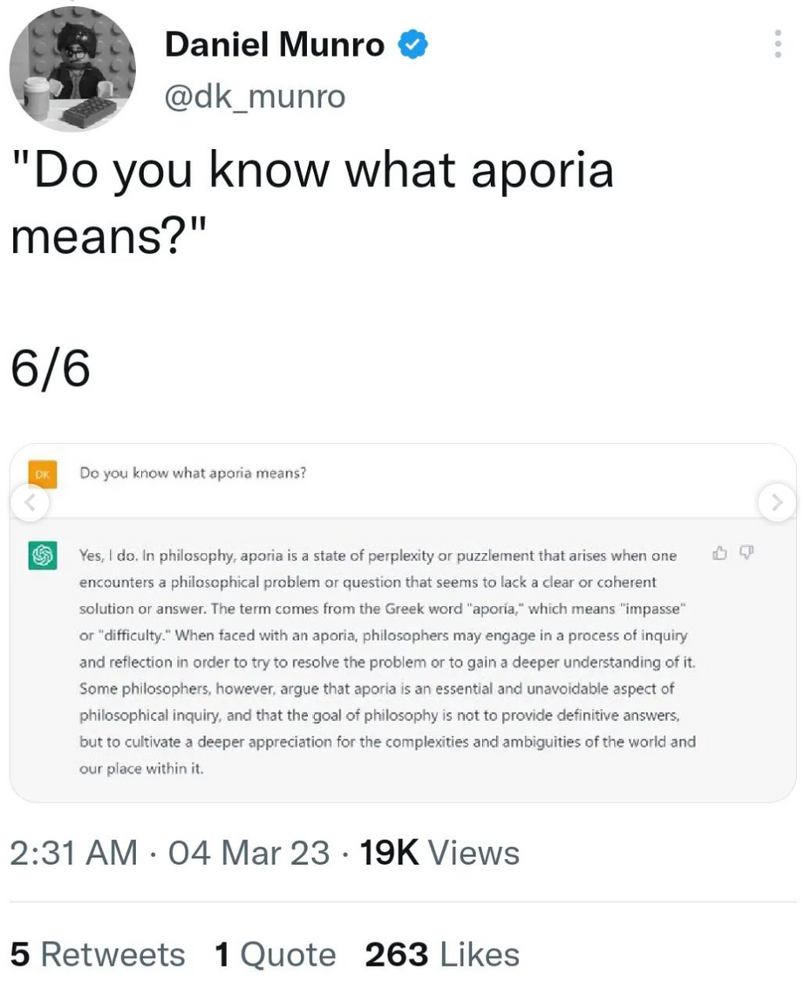

Slide 11
What does the Stanford Encyclopedia of Philosophy (SEP)
say a philosopher is?
Let's look together

Slide 12
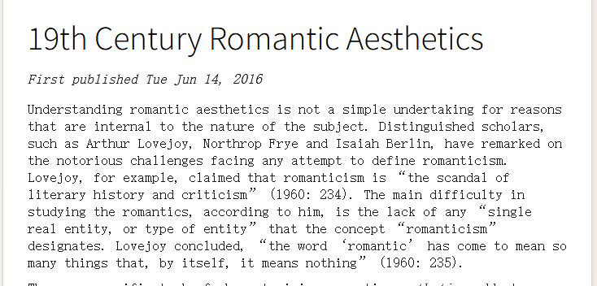

What is the SEP
SEP is a widely cited, authoritative source known for its high-quality bibliographies and comprehensive tracking of philosophical discourse. Maintained by Stanford University and freely accessible online, the SEP offers expert-written articles on a wide range of philosophical topics, regularly updated to reflect the latest developments in the field.

Slide 13
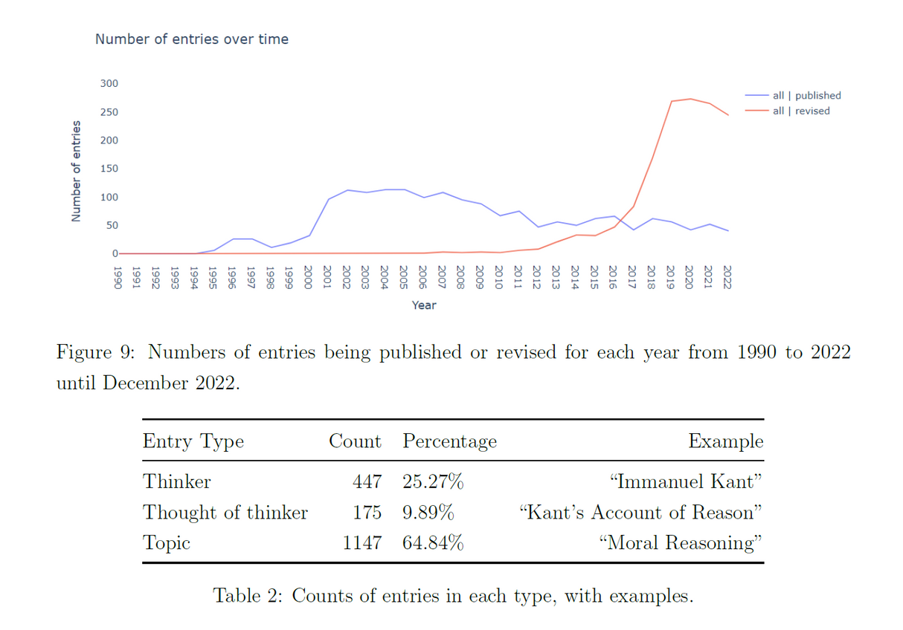
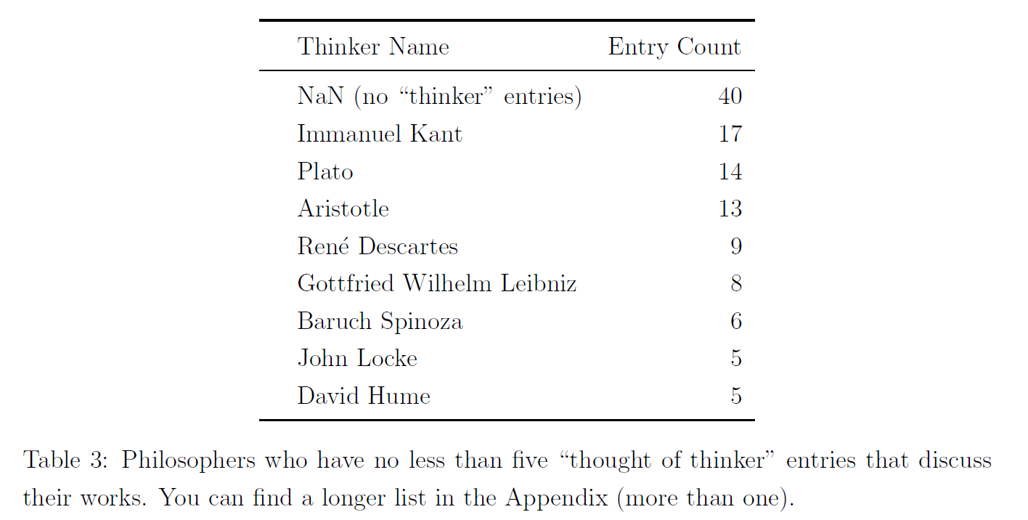
SEP Summary

Slide 14
What does the Stanford Encyclopedia of Philosophy (SEP)
say a philosopher is?
Out of 447 thinker entries, 27 thinkers are women. In other words, only 6% of the SEP thinker pages are women—specifically, only 6% are described by she/her pronouns instead of he/him.
White, European, cisgender men....so what?

Slide 15
If the SEP is recommended to every philosophy student, what is this telling its audience? Did women philosophers not exist before the 1500s? Do they not exist outside of the Western tradition?

Slide 16
Healing a Divide
The current philosophical landscape does not include women or marginalized groups.
However, it is not that these groups aren't there. It is that they have been silenced. Computational methods can help us bring to light these voices.

Slide 17
Pilot Study:
Semantic Analysis of the Elisabeth-Descartes Correspondences
The correspondence between Princess Elisabeth and Ren´e Descartes serves as a test case to determine the feasibility of this approach.
  Human perspective: utilize Lisa Shapiro’s index to identify the topics covered in the correspondence and employ topic modeling to analyze the frequencies of different themes over time.
  Machine perspective: Bertopic and network analysis methods will be employed to visualize and analyze the philosophical themes discussed across texts and their connections

Slide 18
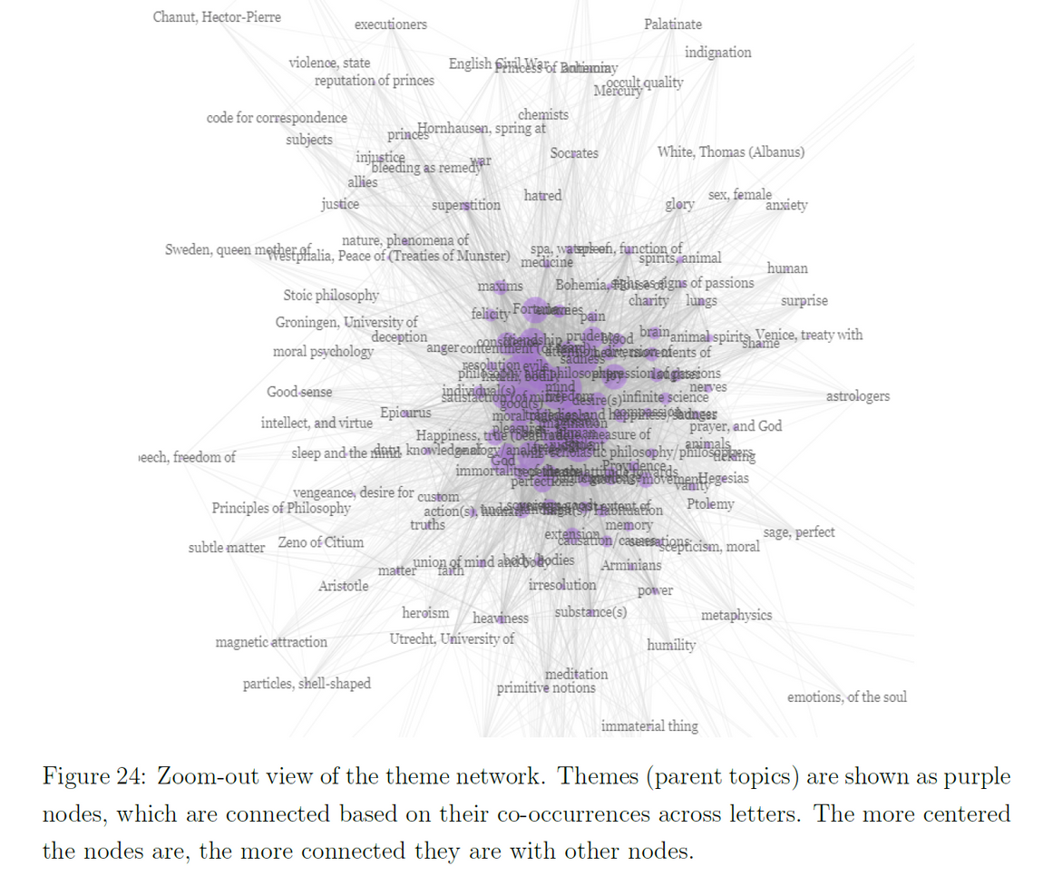
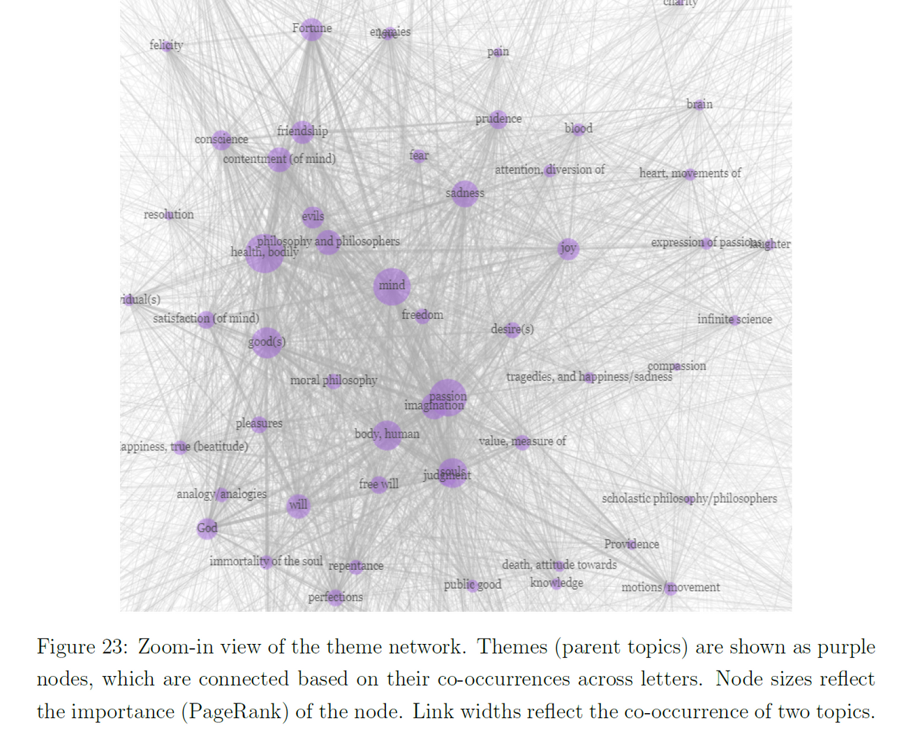
Human-drawn Topics
Co-occurrence of topics

Slide 19
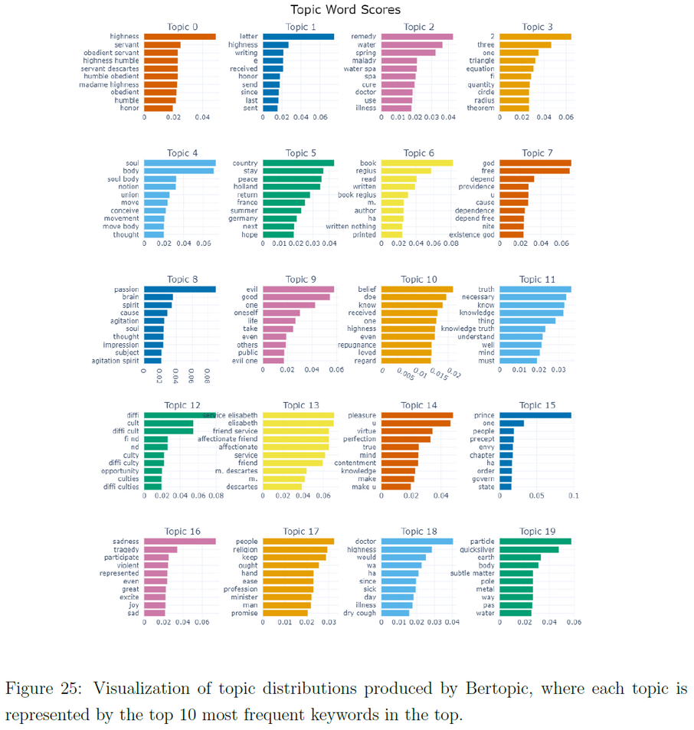
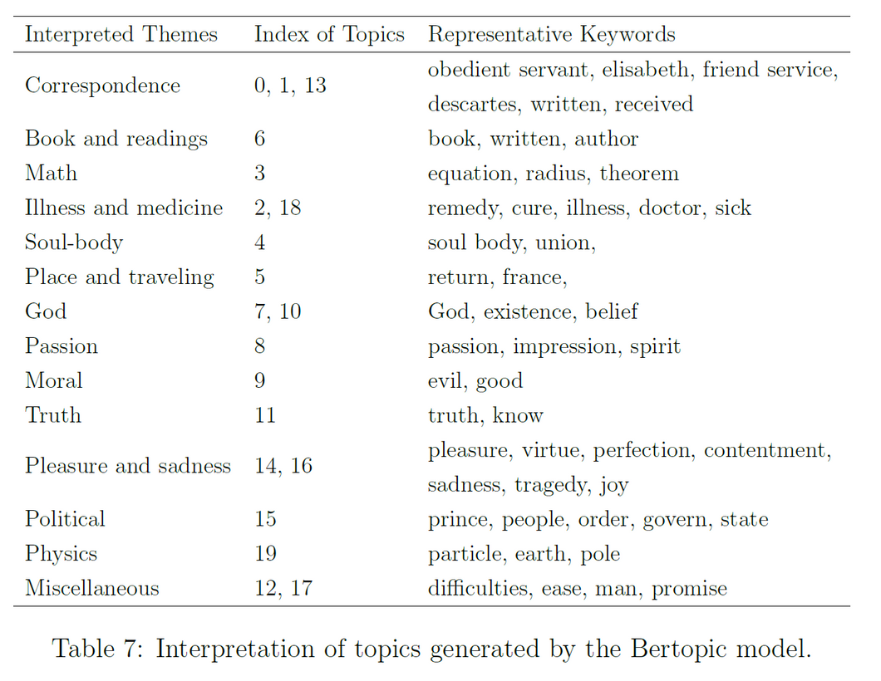
Topic Modeling
Bertopic

Slide 20
Highlights:
Connections and re-examination
  What is philosophy?
  What makes a philosopher?
  What is data?
'My' netowork:
Junyi Tao, Prof. Lim, Prof. Janiak, Kelsey, Emilie, Prof. Anderson... and all of professors who consulted with us

Slide 21
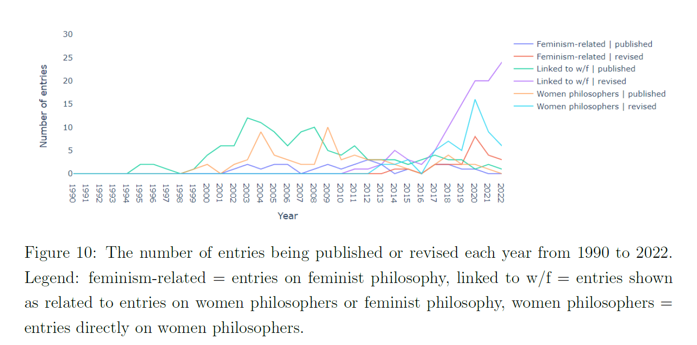
SEP: visibility and representation
  Count of entries related to women philosophers and feminist philosophy

Slide 22
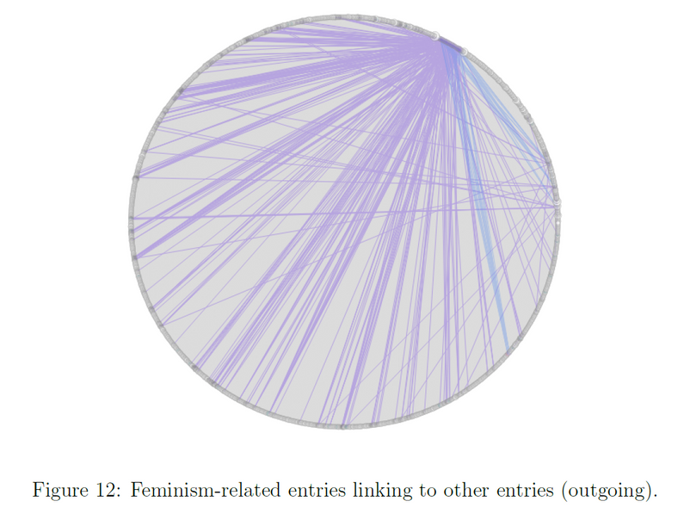
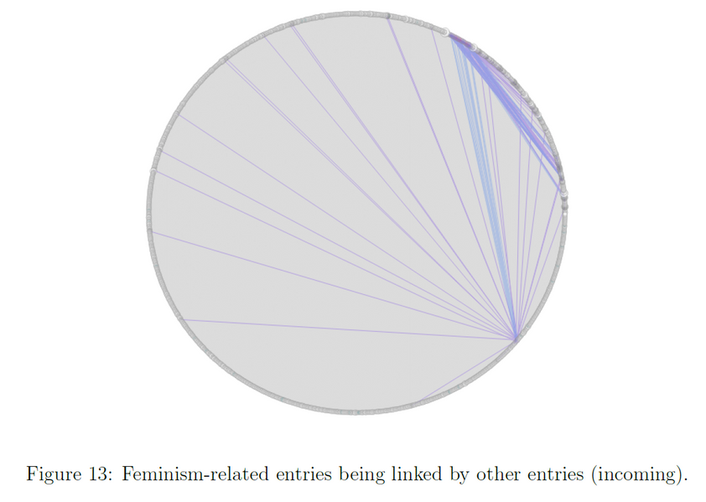
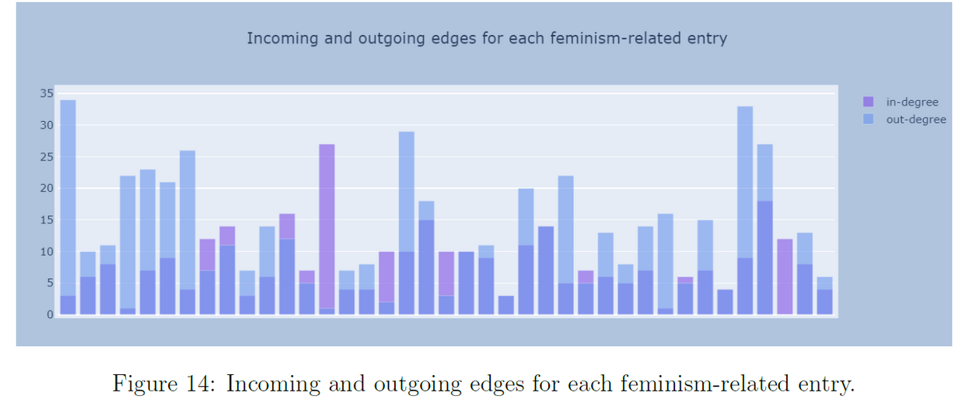
2. Related Entries Network: feminism-related entries
connected to other entries

Slide 23
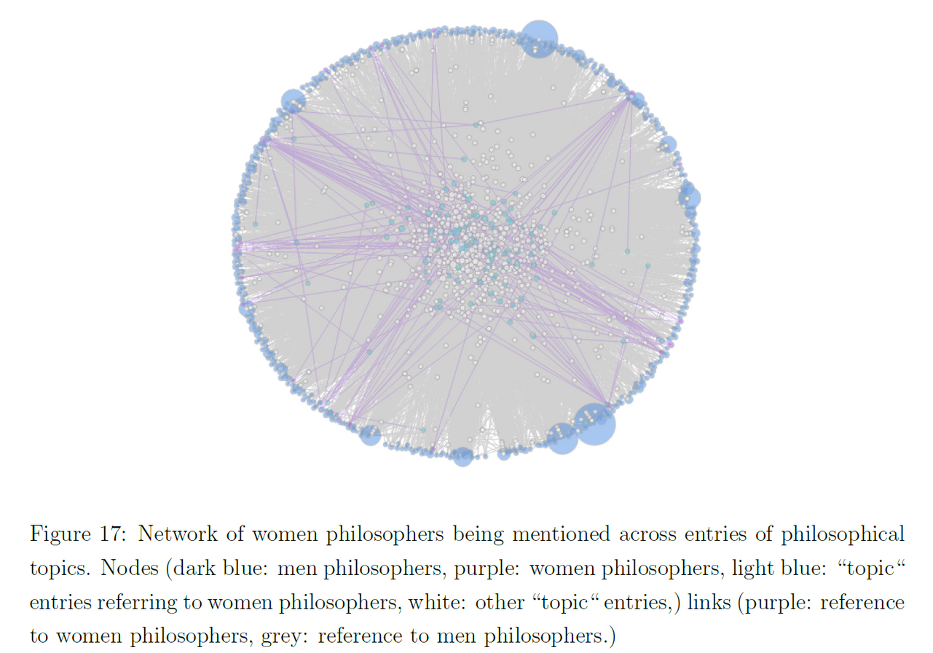
3. Thinker reference network: women philosophers (with entries) being
mentioned across entries [by entries of philosophical topics]

Slide 24
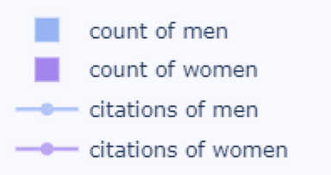
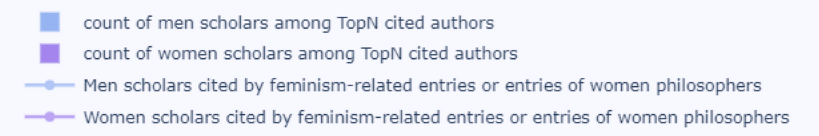
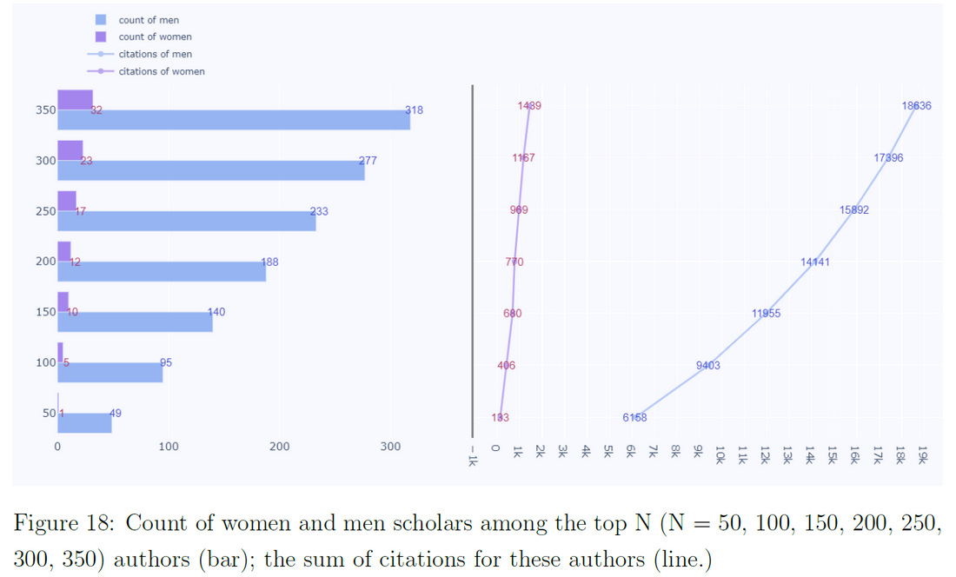
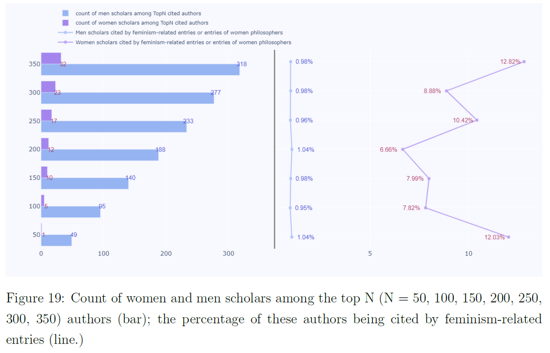
4. Citations: women authors being cited across entries
extracted 228,130 authors and 190,049 cited works from the bibliography
72,225 distinct author names
165,076 different works

Slide 25
Conclusions
  Female philosophers are simultaneously overrepresented, as demonstrated by the increasing prominence of feminist philosophy,
  and underrepresented, as women thinkers are often overlooked in discussions of the topics they have contributed to.
This finding offers an opportunity to reshape the discourse surrounding marginalization and exclusion in philosophy.
Although some may argue that the recognition of philosophers on the SEP ultimately depends on their influence and the difficulty of rediscovering their sources, we maintain that it is crucial for influential platforms like the SEP to strive for increased representation of historically marginalized groups. Given its influence among both non-academic and professional audiences, the SEP can significantly contribute to promoting diversity in the field.

Slide 26
Philosophy in the 1600-1800: Correspondences
  Exploring philosophical discussions as networks of exchanged ideas and concepts.
  Goal
    employ advanced visualization techniques and computational methods in order to better understand the exchange of philosophical ideas in historical correspondences,
  At the same time:
    how did philosophy work at this time?
    Who were philosophers?
    How can we represent the people and their ideas without everyone doing a close reading?

Slide 27
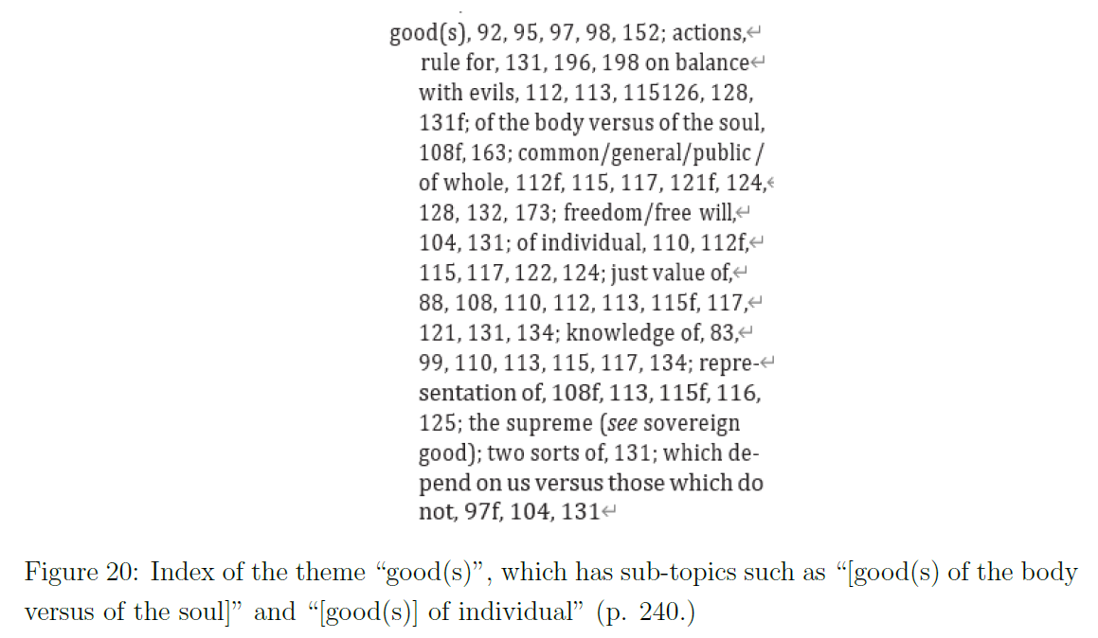

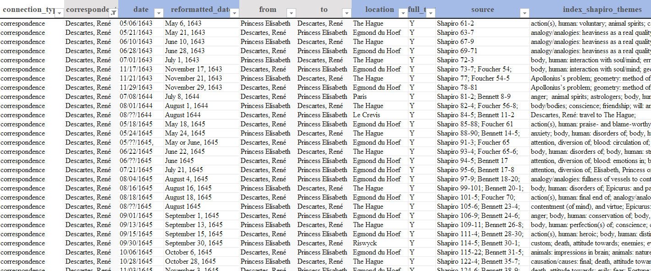
The index is organized into themes and sub-topics, with 173 parent topics and 507 sub-topics in total.

Slide 28
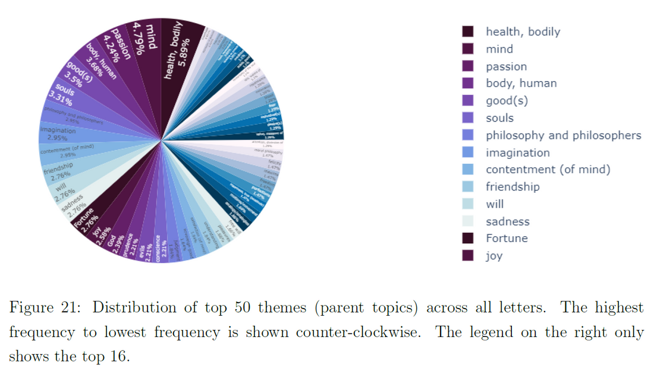
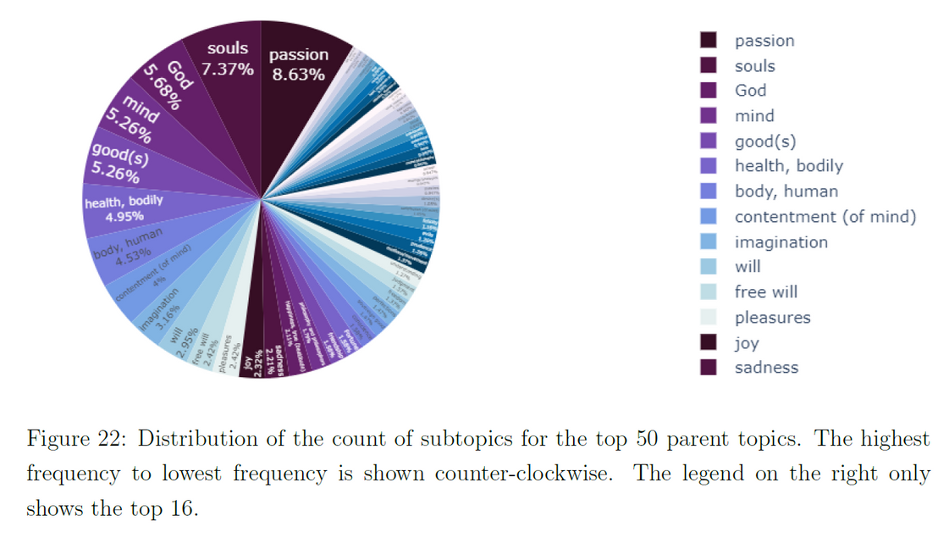
Human-drawn Topics
Top 50 topics

Slide 29
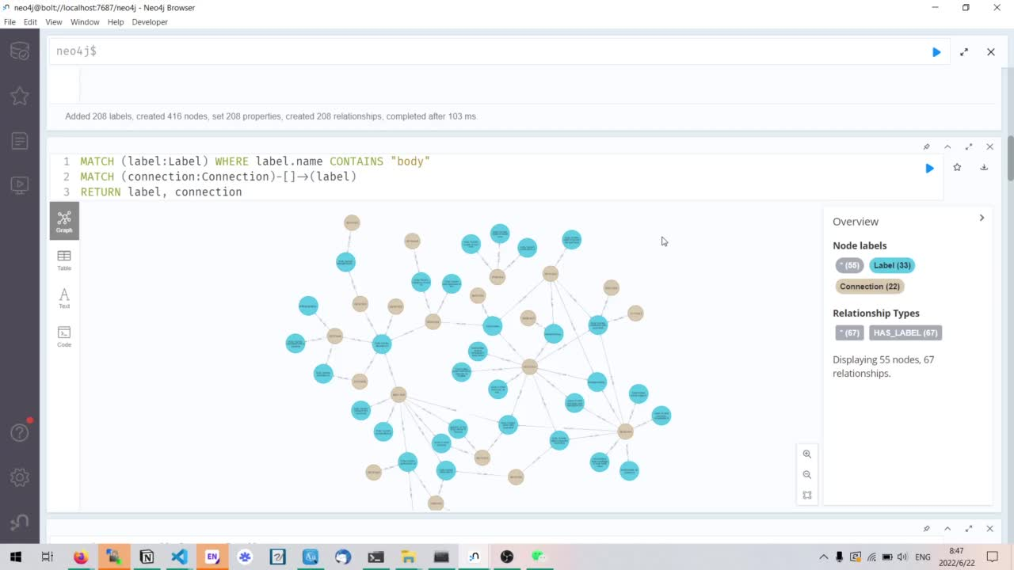
Human-drawn Topics
Query topics

Slide 30
Comparison
Computer-generated results are often viewed as agnostic since they are based on the statistical distribution of words, without predefined hypotheses or assumptions. In contrast, the index is grounded in the author’s interpretation of the texts.
Comparing the two approaches can reveal interesting insights.
  see what is typically considered philosophically significant.
  identify topics and connections that might have been overlooked but hold considerable historical and research value for understanding the thinkers and their thoughts in the context of their lives.

Slide 31
Conclusions
"This life was not limited to what we consider to be ‘philosophy’ today—it includes math and science and the mundane updates one supplies a friend." -- quote from Karen
Comparing the two helps us identify topics and connections that might have been overlooked but hold considerable historical and research value for understanding the thinkers and their thoughts in the context of their lives.
The goal of this study is to demonstrate methods for showcasing connections at scale in
the context of philosophical discussions.
Moving forward, the plan is to scale up this project to include more philosophers and analyze additional correspondences from the early modern period.

Slide 32


Slide 33
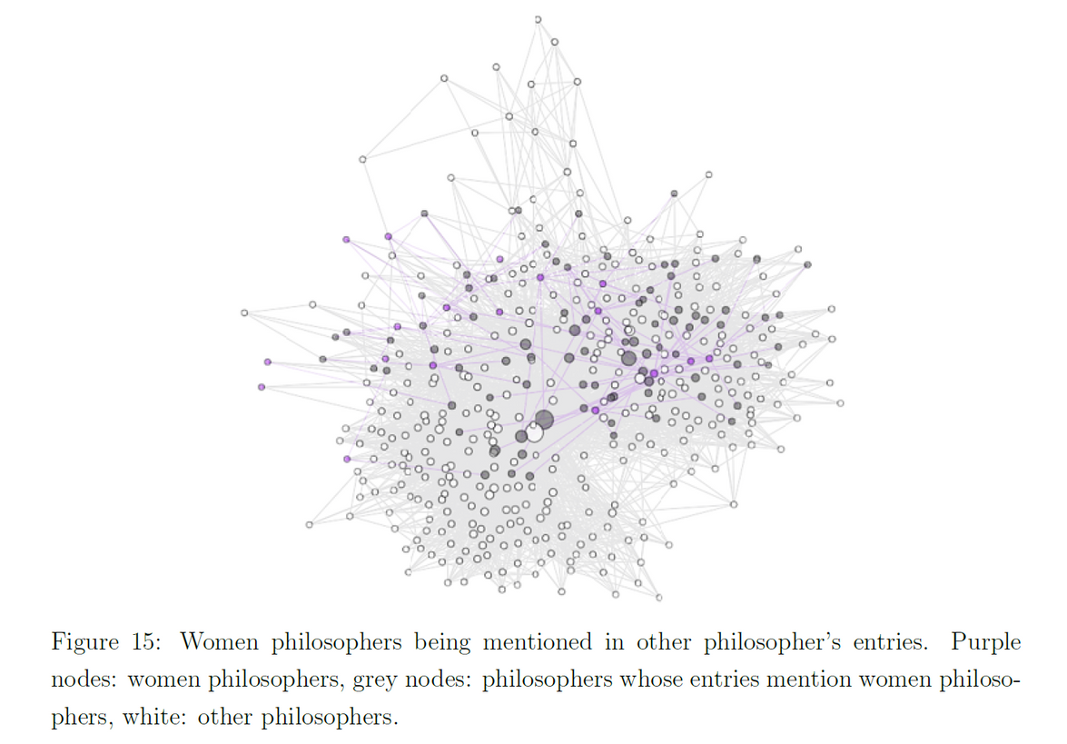
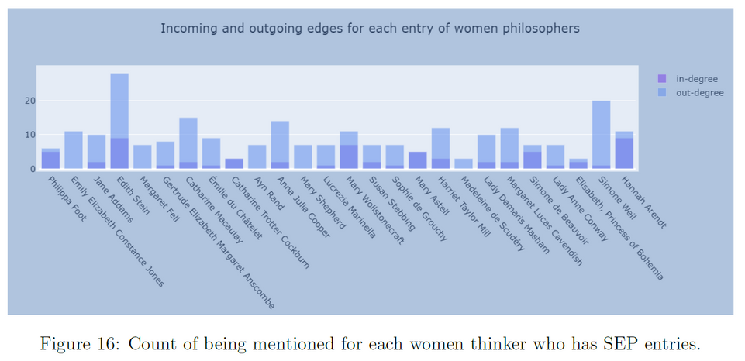
Thinker reference network: women philosophers (with entries) being
mentioned across entries [by entries of thinkers]

Slide 34
Semantic Analysis of the Elisabeth-Descartes Correspondences
The previous two case studies have focused on examining the networks of philosophers and conducting sociological investigations of contemporary philosophical discourse. This case study shifts focus to the content level, exploring philosophical discussions as networks of exchanged ideas and concepts. The motivation behind this case study is to employ advanced visualization techniques and computational methods to better understand the exchange of philosophical ideas in historical correspondences, particularly between Princess Elisabeth of Bohemia and Ren´e Descartes.
The correspondence between Princess Elisabeth and Ren´e Descartes serves as a test case to determine the feasibility of this approach.
  Human perspective: utilize Lisa Shapiro’s index to identify the topics covered in the correspondence and employ topic modeling to analyze the frequencies of different themes over time.
  Machine perspective: Bertopic and network analysis methods will be employed to visualize and analyze the philosophical themes discussed across texts and their connections

Slide 35
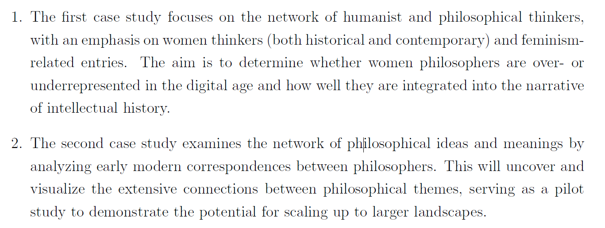
Research Objectives

Slide 36
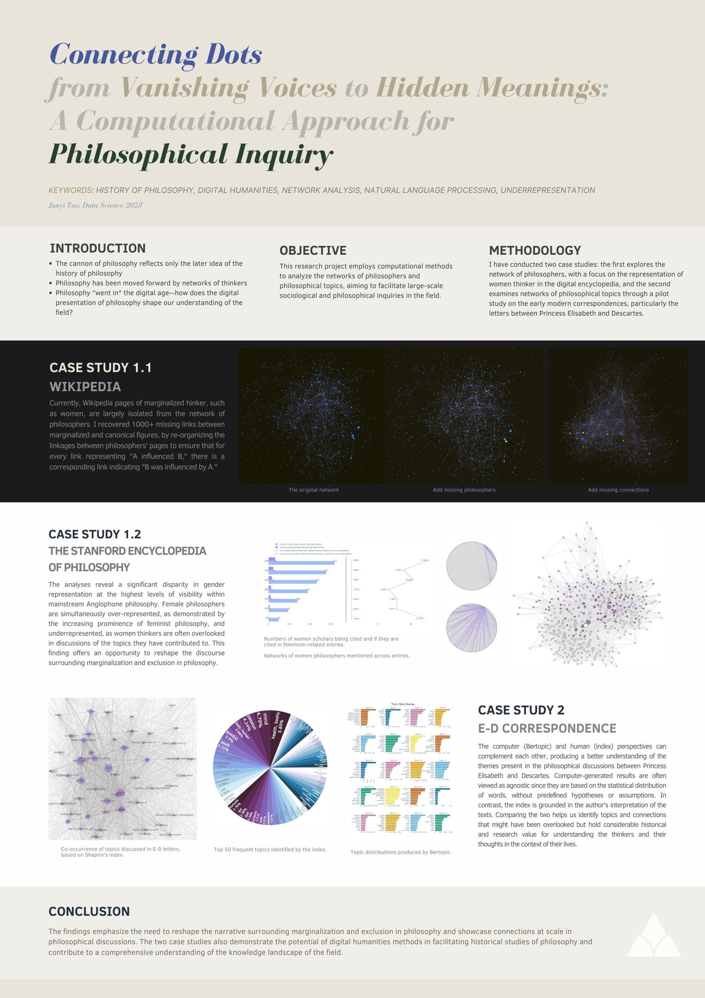



Slide 37
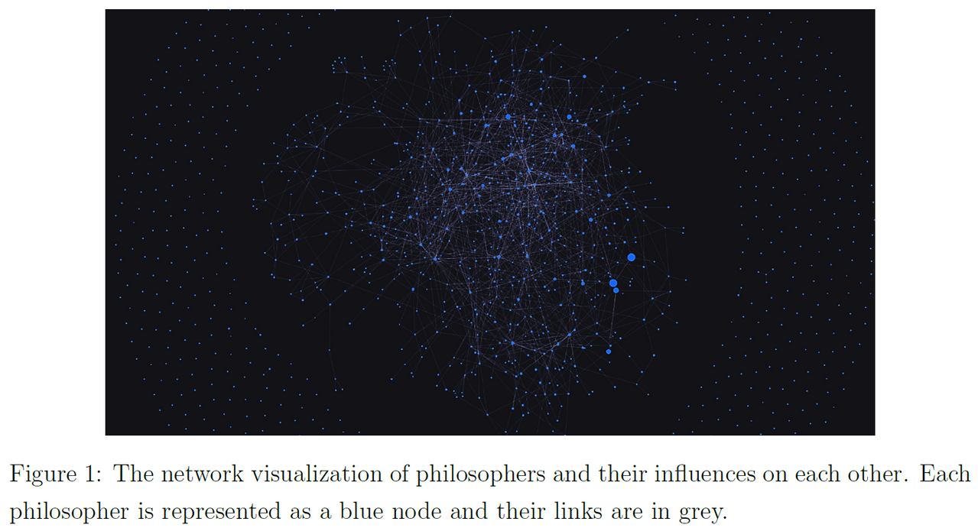
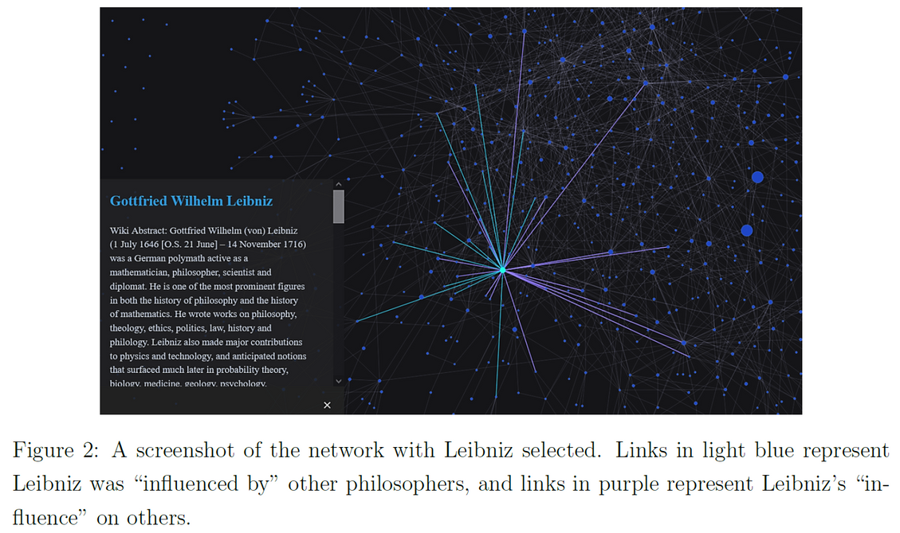
Visualizing missing voices in the history of philosophy:
A network analysis of philosophers on Wikipedia
crawl data from Wikipedia pages of philosophers representing their influence on each other
-> create a network visualization to identify marginalized figures in this network -> analyze the pattern of links causing such marginalization

Slide 38
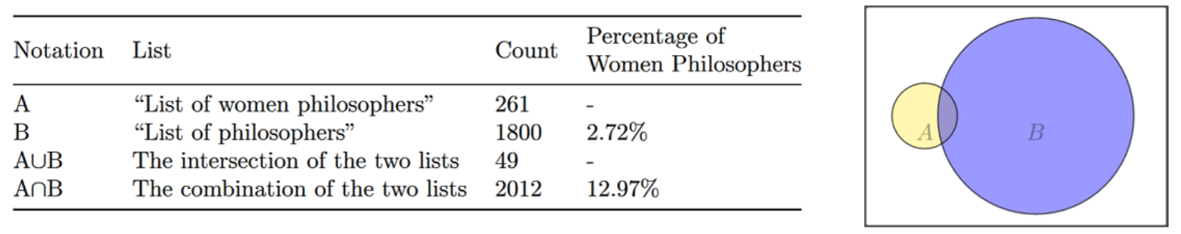
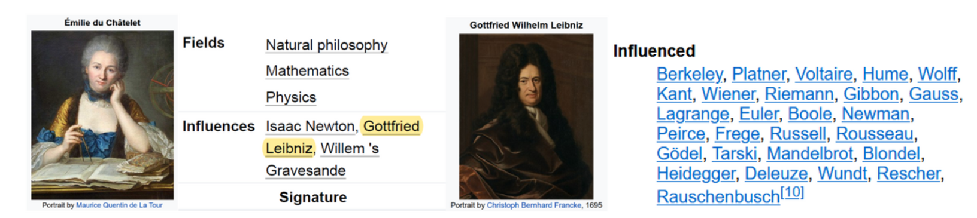
Inclusion & Integration
Screenshots of du Chˆatelet and Leibniz’s Wikipedia pages. People who have influenced them are listed in the “influences” section, and those they influenced are mentioned in the “influenced” section. Accessed May 28, 2022.

Slide 39
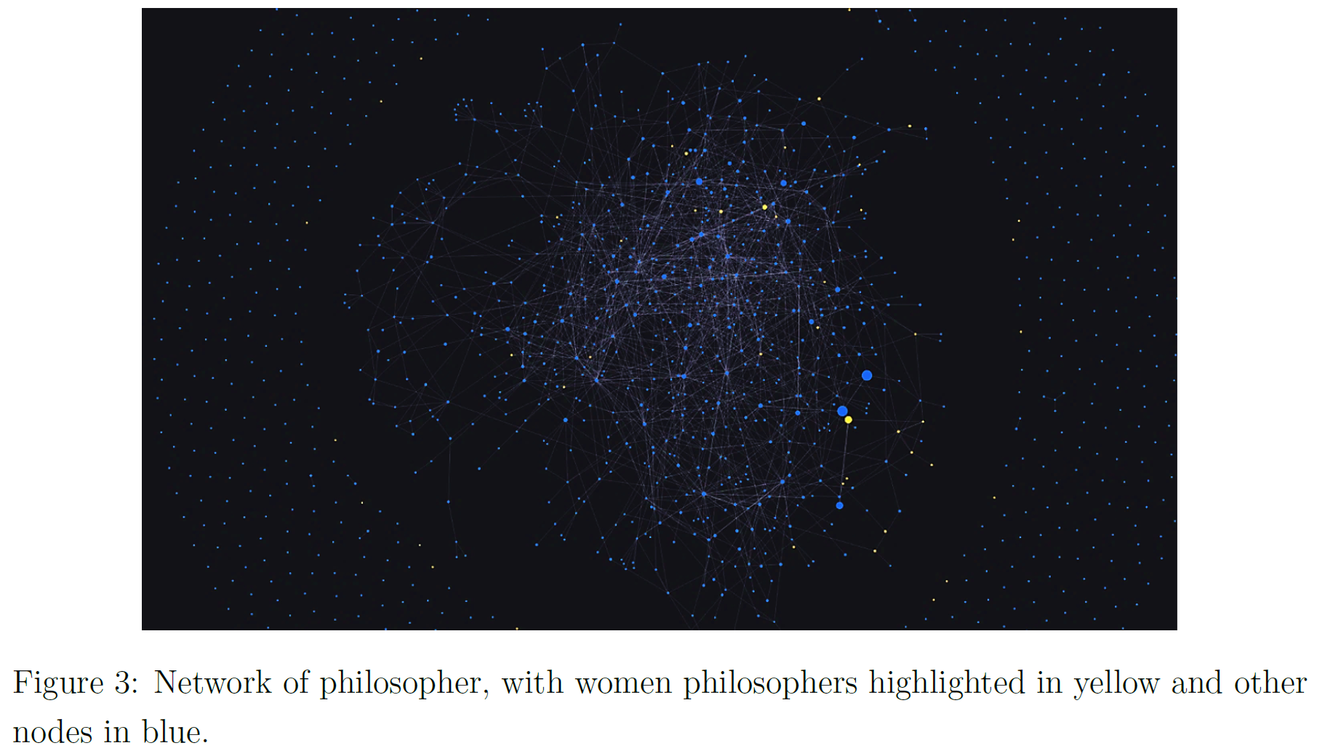

Slide 40
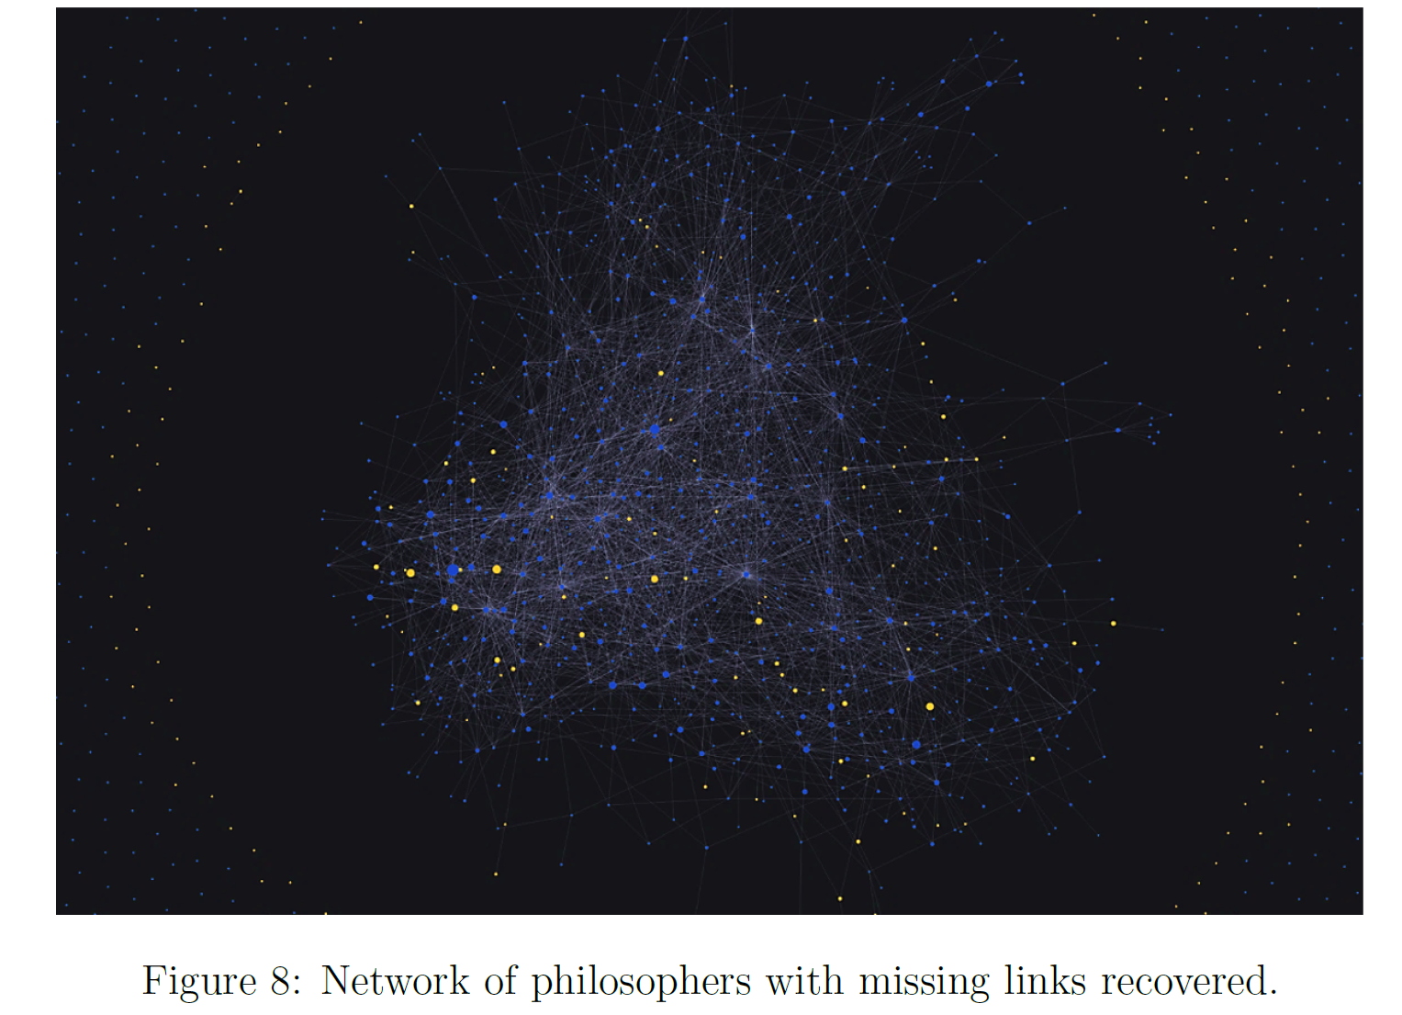

Slide 41
All done in 6 weeks :)
With Project Vox Team

Slide 45






Appendix

Slide 46
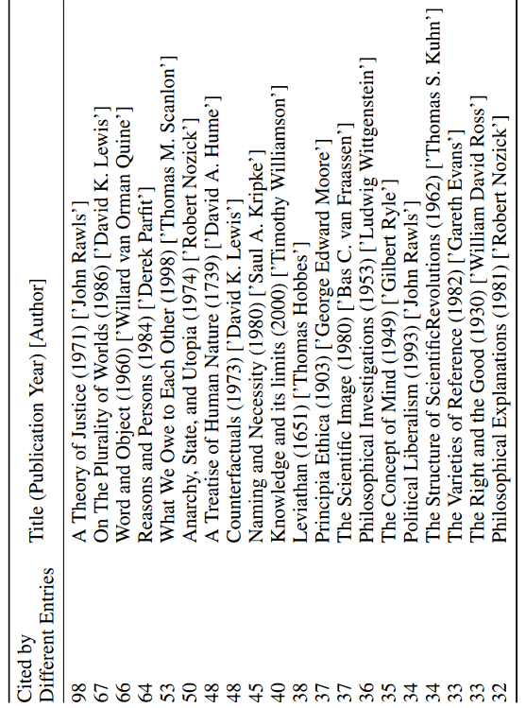
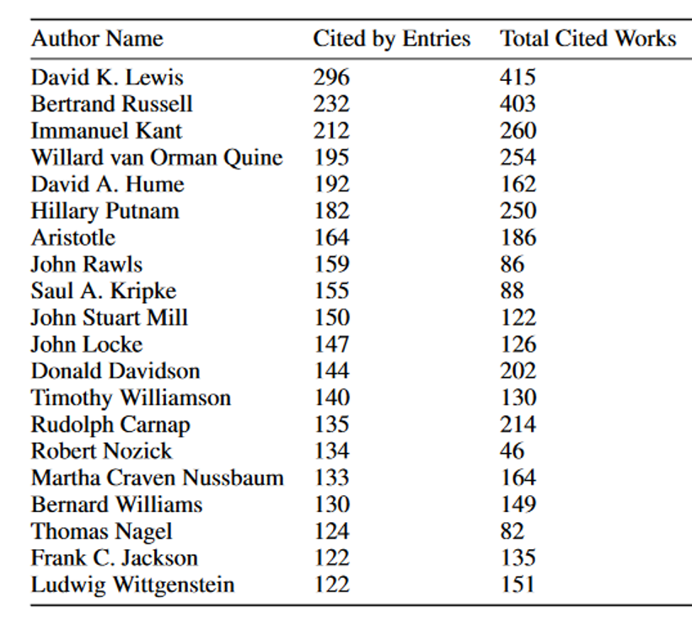
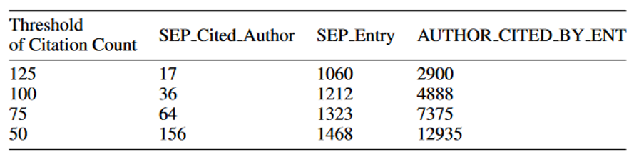
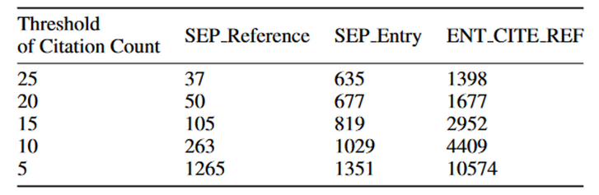
Top Cited Authors
Top Cited Works

Slide 47

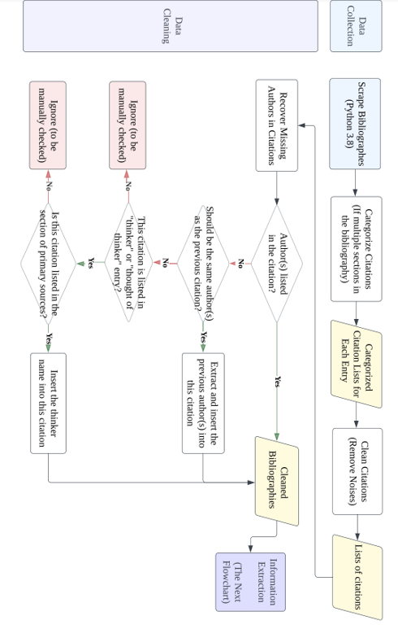
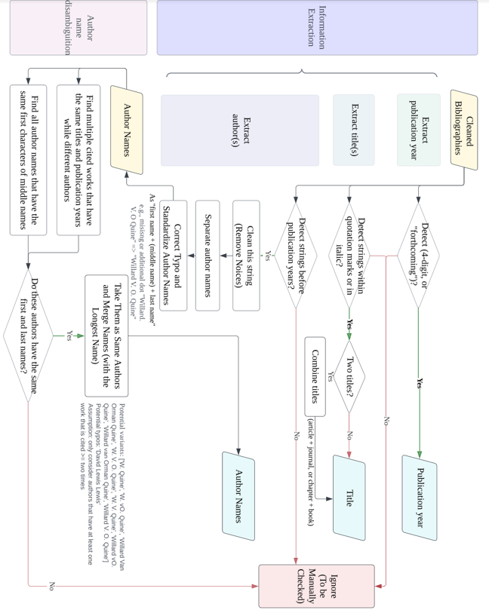
Database Construction

