Slide 1


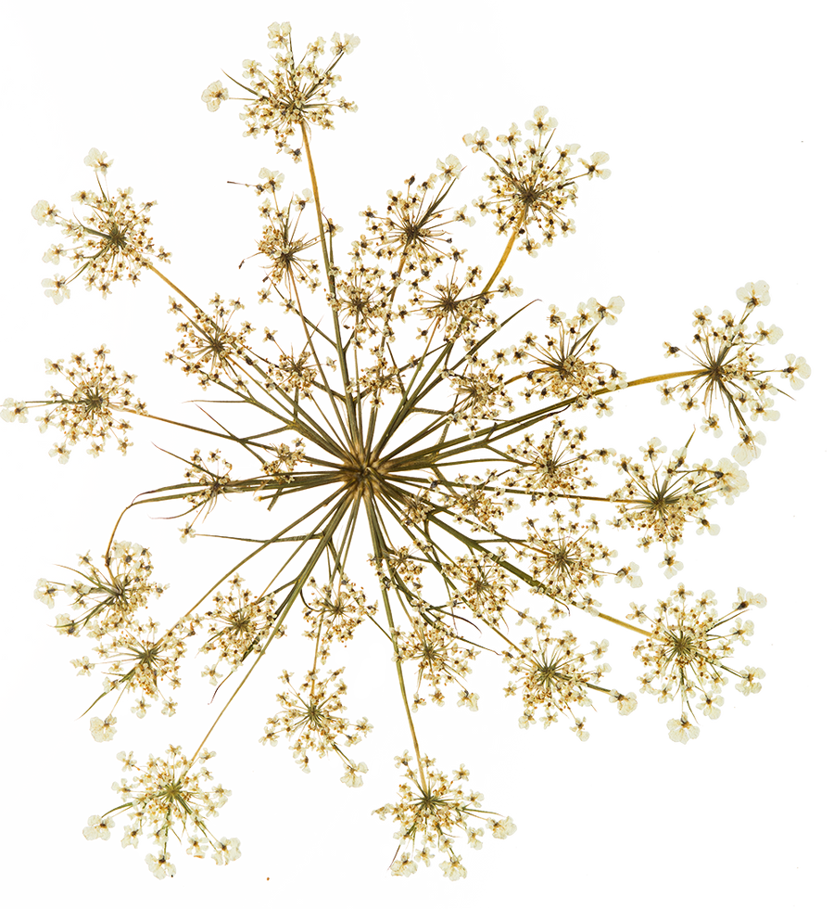


Marginalized and forgotten
WOMEN
PHILOSOPHERS
Presented by: Junyi Tao and Karen Nielsen
Notes:
- visualization of women philosopher netork

Slide 2

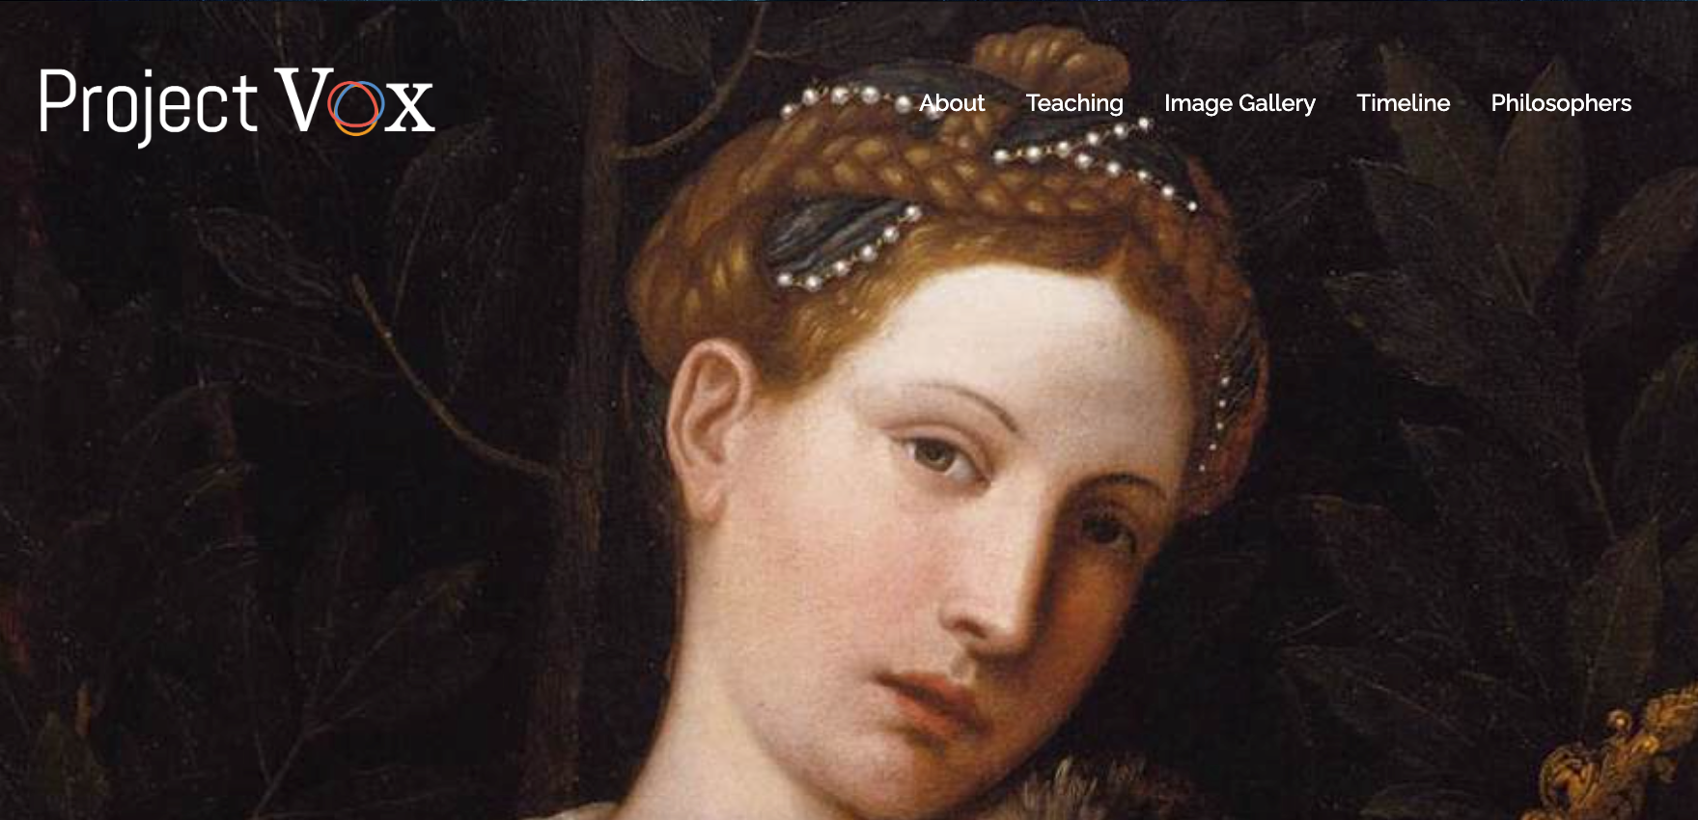

Notes:
What is Project Vox?
- website
- bring to light the missing voices
- non canonical philosophers into research and teaching materials

Slide 3

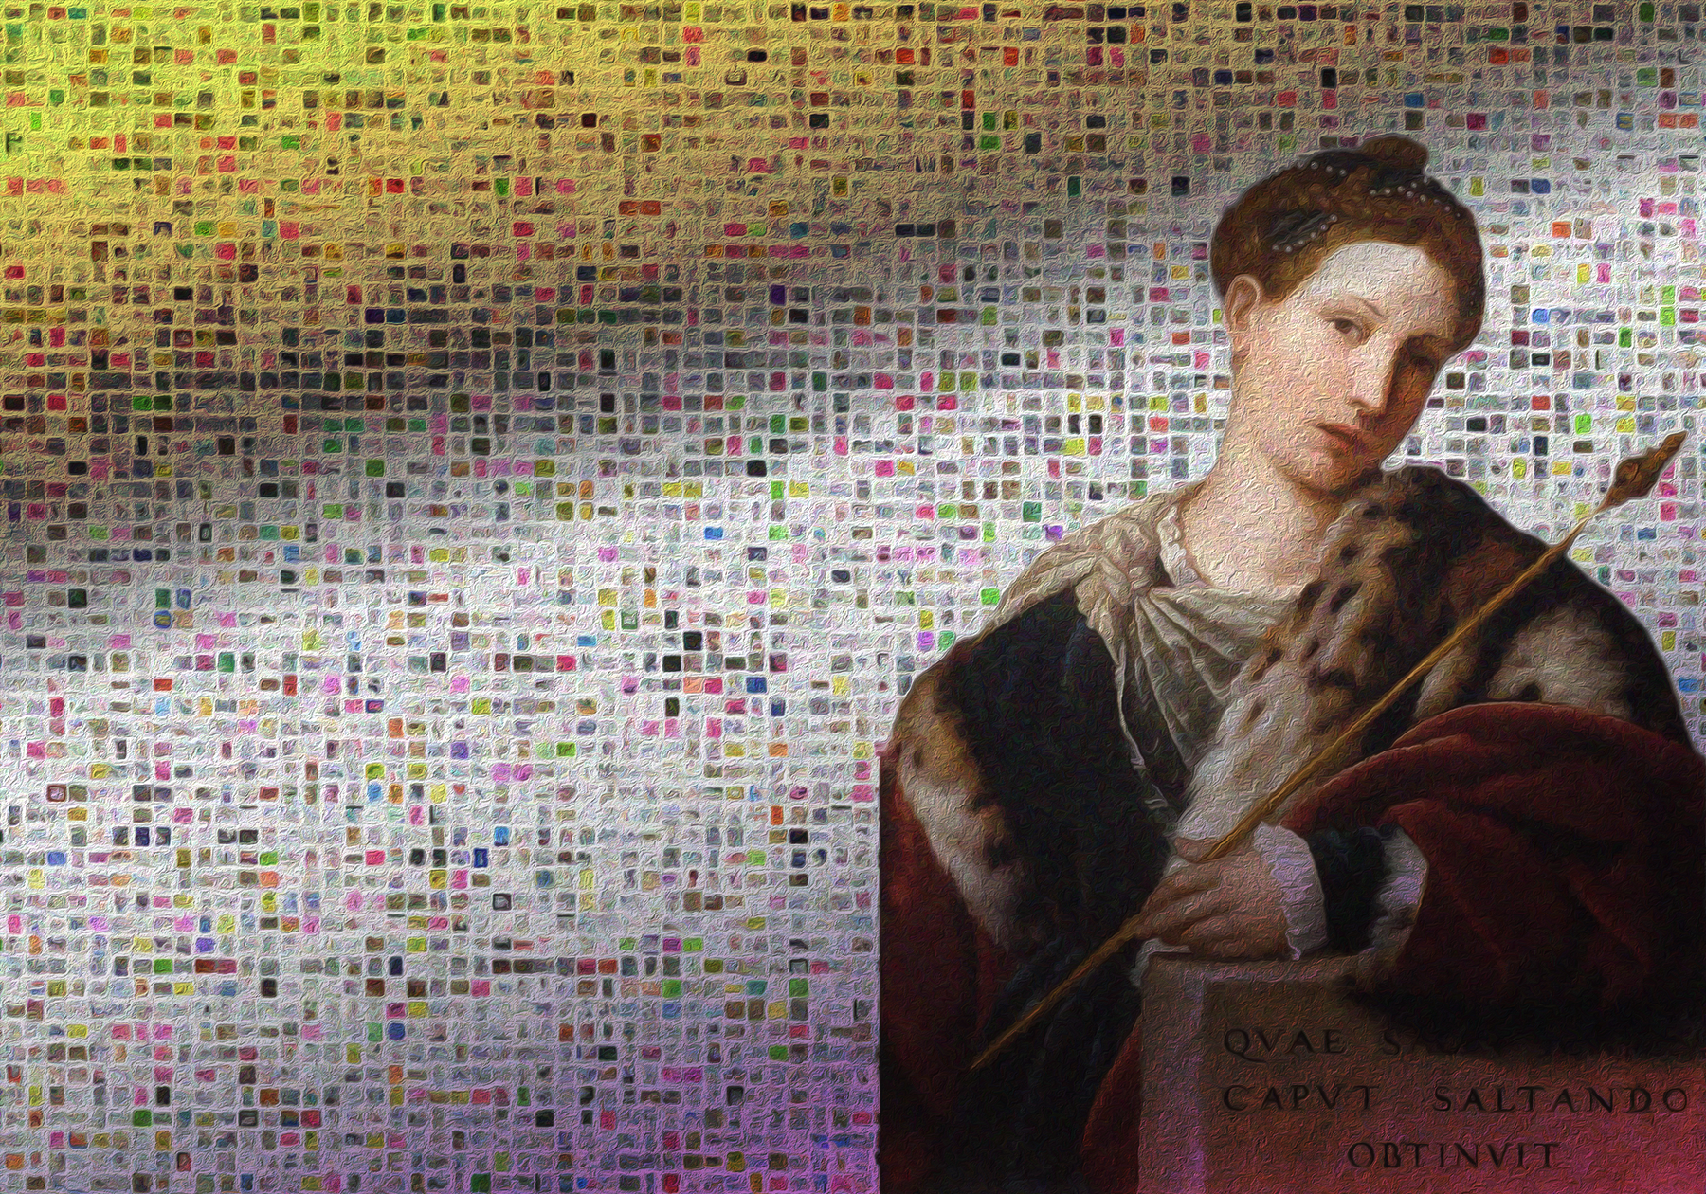
Mission & Research Purpose
- Expand and challenge the traditional philosophical canon
- Feature philosophers unjustly ignored and excluded from the narrative of the history of philosophy.
- Provide resources to educators and students who would like to work on philosophers beyond that canon.
Notes:
Junyi

Slide 4
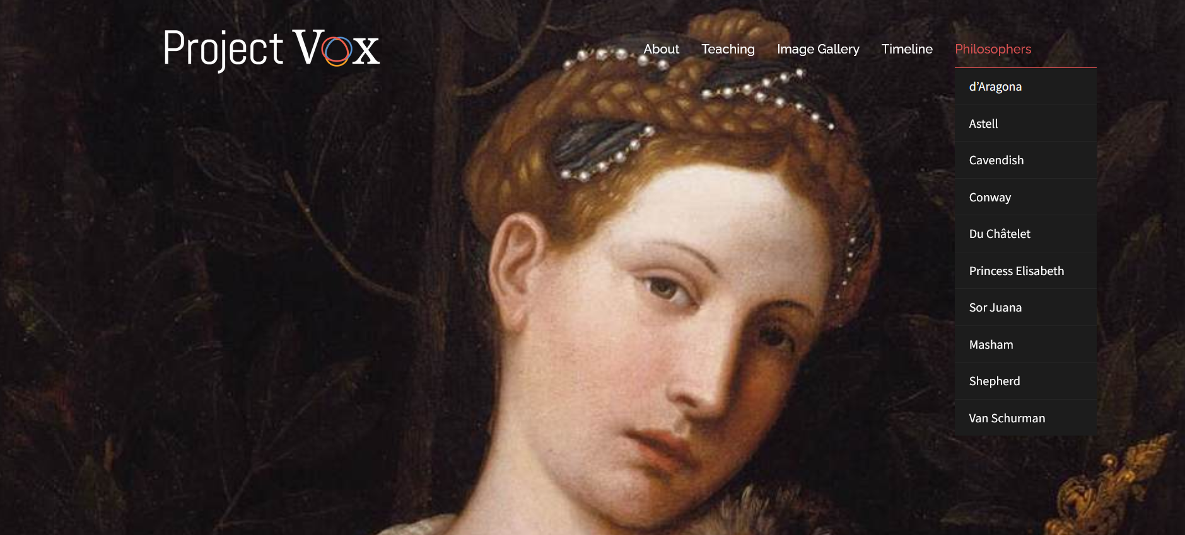
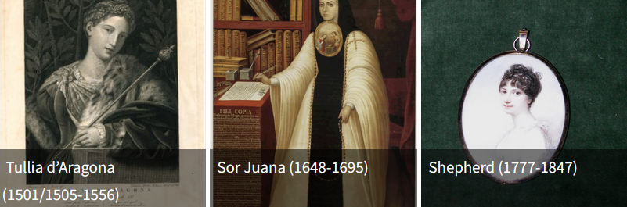
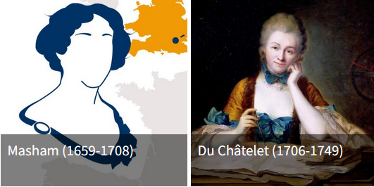
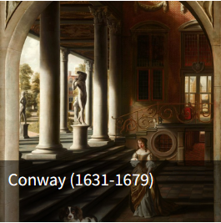
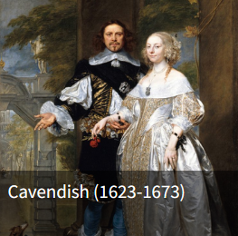
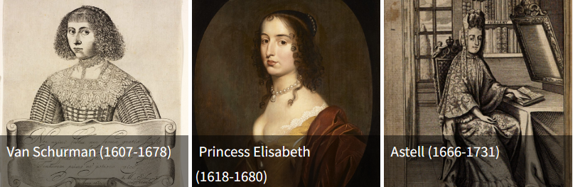
Notes:
Numerous women during the early enlightenment
expanding beyond women and this time period.. what other voices are there? How can we tell those voices? What languages? Where?

Slide 5



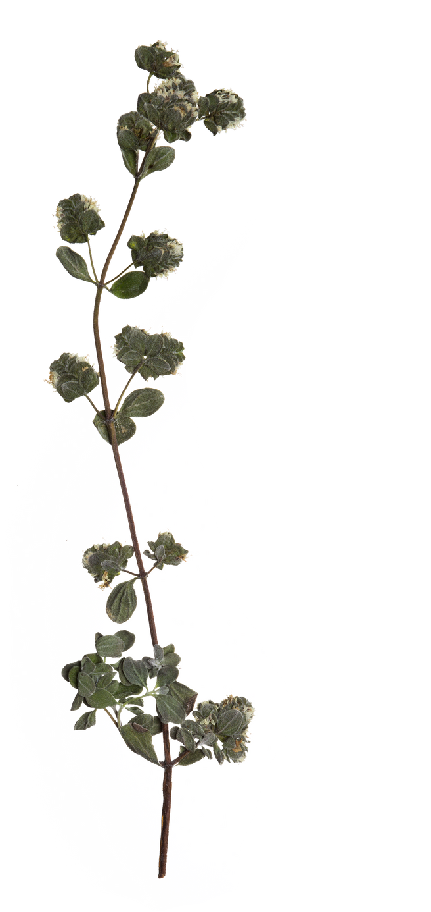
Why Necessary?
    Nodes: Philosophers
      Philosophers listed
      in Wikipedia
    Links: Their influence on peers
      Influence listed
      in Wikipedia
A Wiki InfluNet...
    Did not start out looking for bias
Notes:
Karen ???

Slide 6
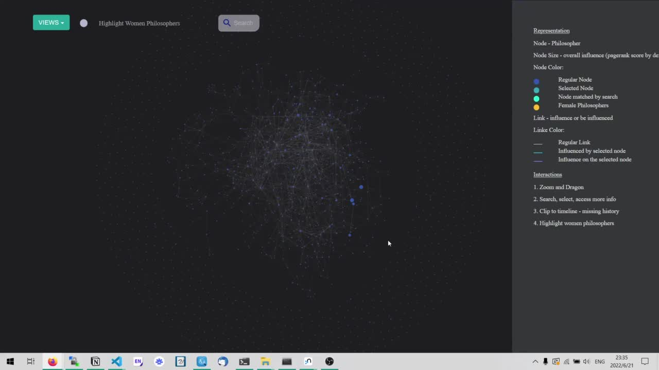
Notes:
Junyi

Slide 7
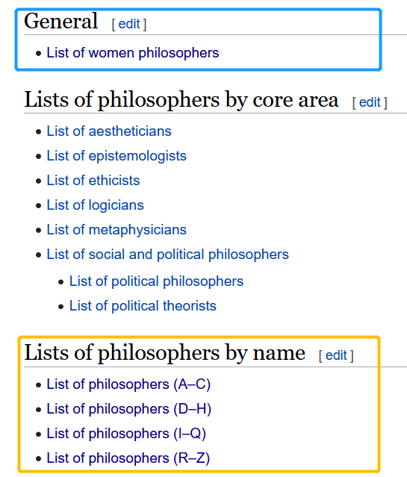
Who are considered as philosophers?
Women Philosopher List
Main Philosopher List
Notes:
Junyi

Slide 8
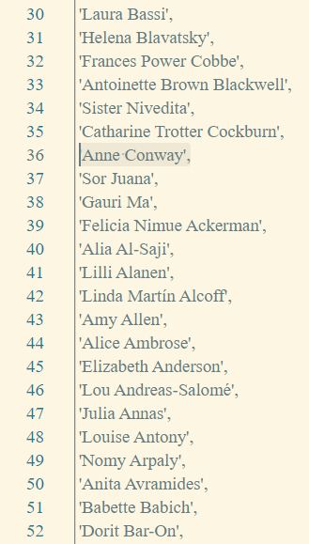

Women Philosophers EXCLUDED from
Main Philosopher List
Women philosophers
are NOT PHILOSOPHERS?
Notes:
Junyi = why are the women not a part of the main list?

Slide 9
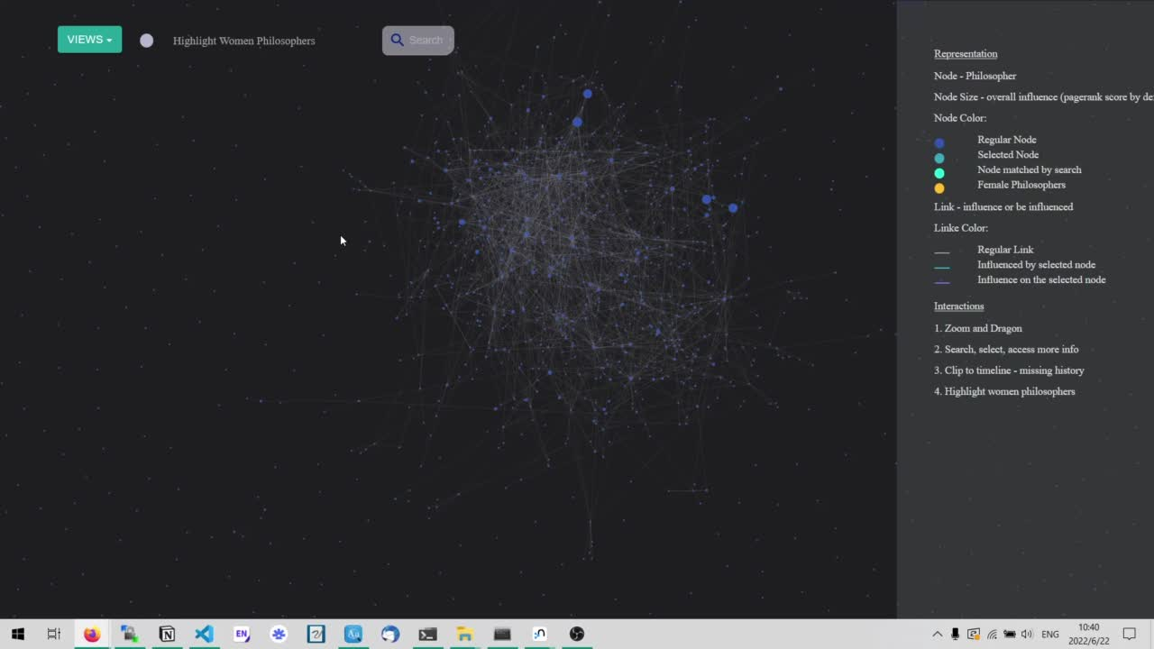
Notes:
Junyi
Now we can see that there are a lot more women

Slide 10
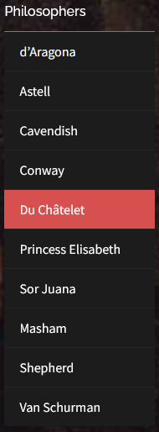
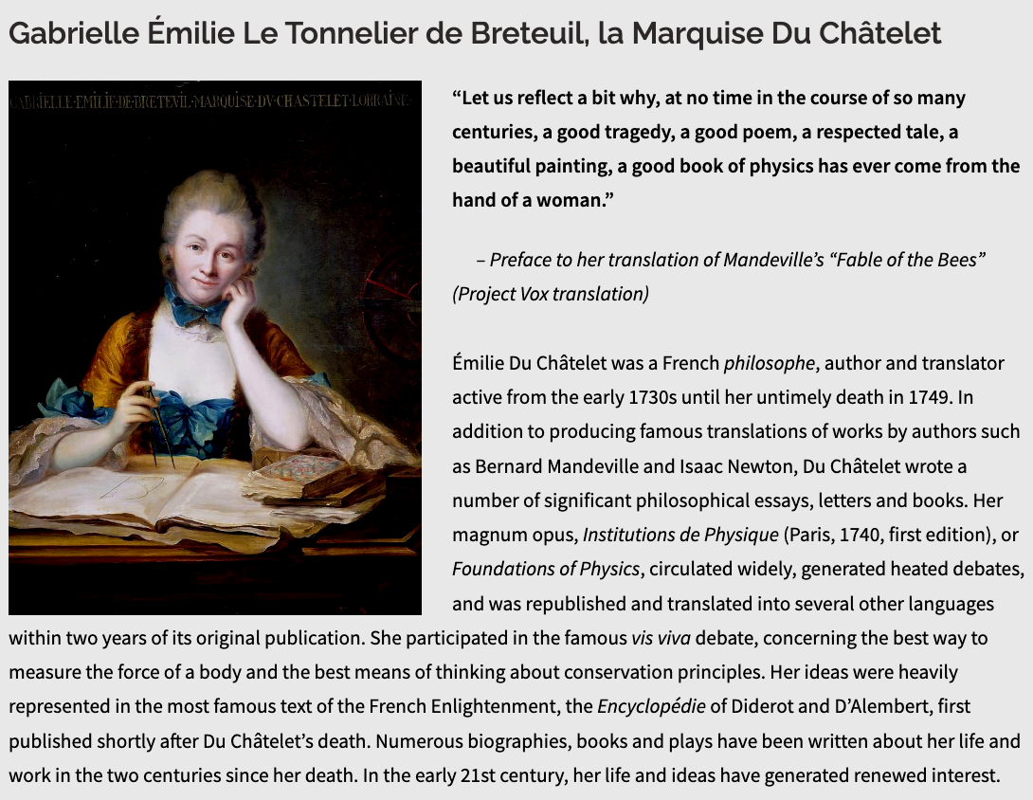
Notes:
Karen
hmmm... What about emilie Du Chatelet
very famous during her time
multiple publications and subsequent discussions
She should have many links....

Slide 11
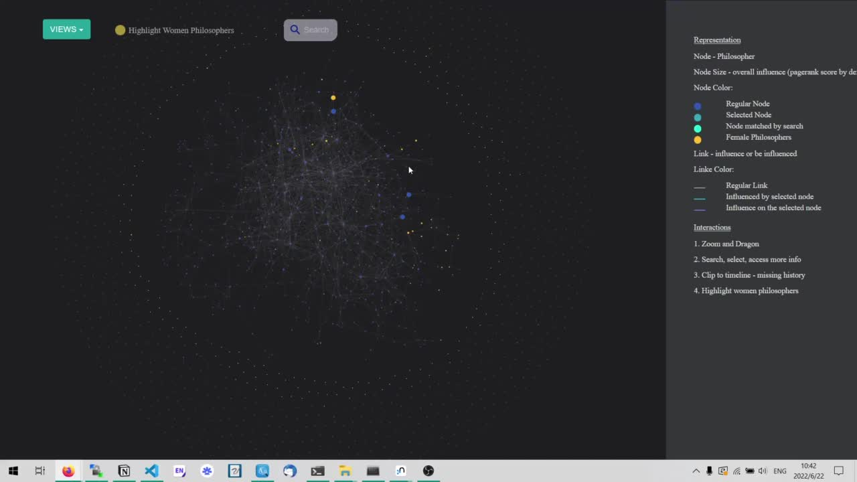
Notes:
Junyi... video search for Emilie Du Chatelet

Slide 12
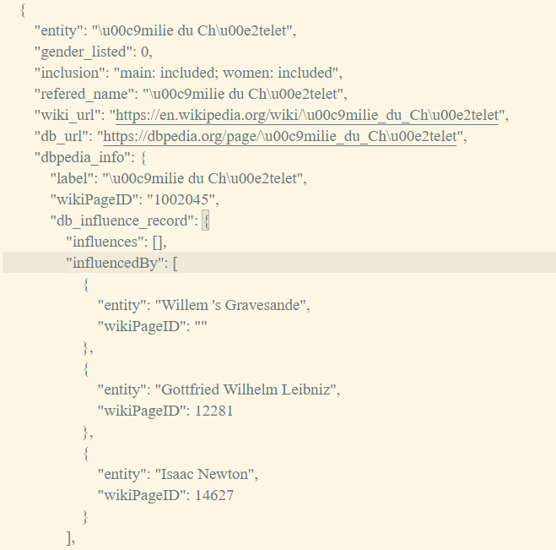
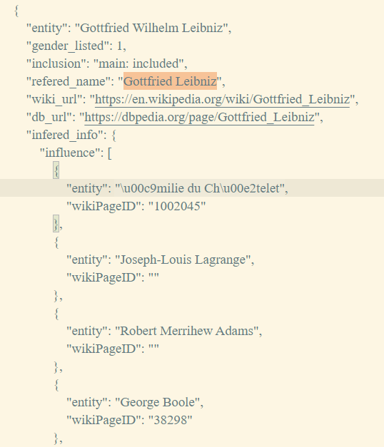
Notes:
Junyi
Influencer Links

Slide 13
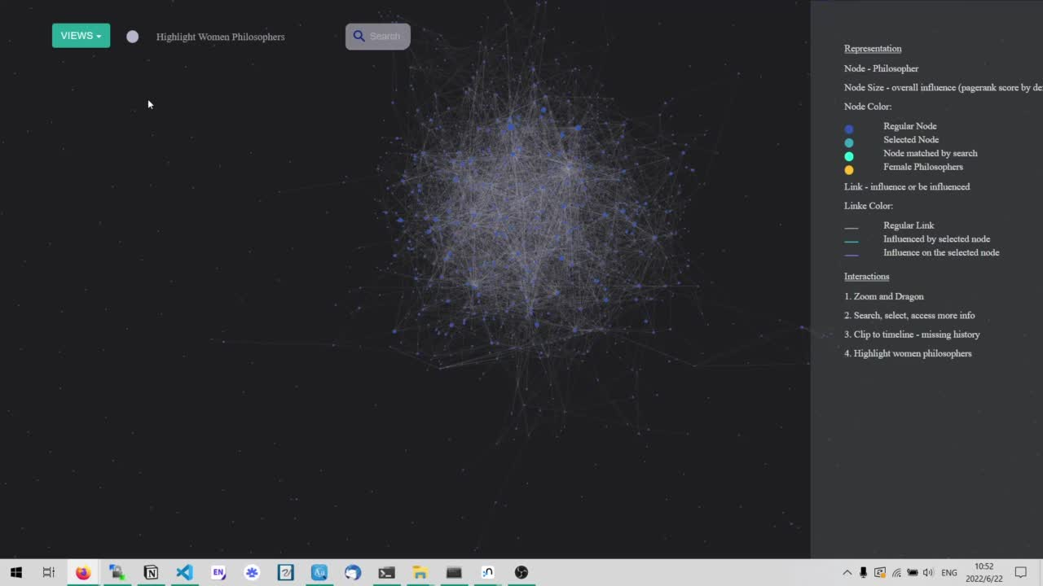
Notes:
Junyi
much more dense

Slide 14

What Can We do?
Wiki InfluNet
Big Data = traditional narrative
Project Vox
Small Data = focus on missing voices
Goal
Restore and Reconnect the Narratives to the Bigger network
Notes:
Karen ....

Slide 15
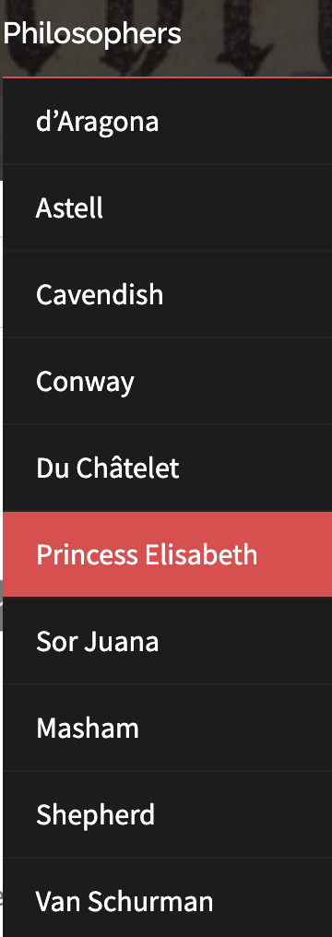
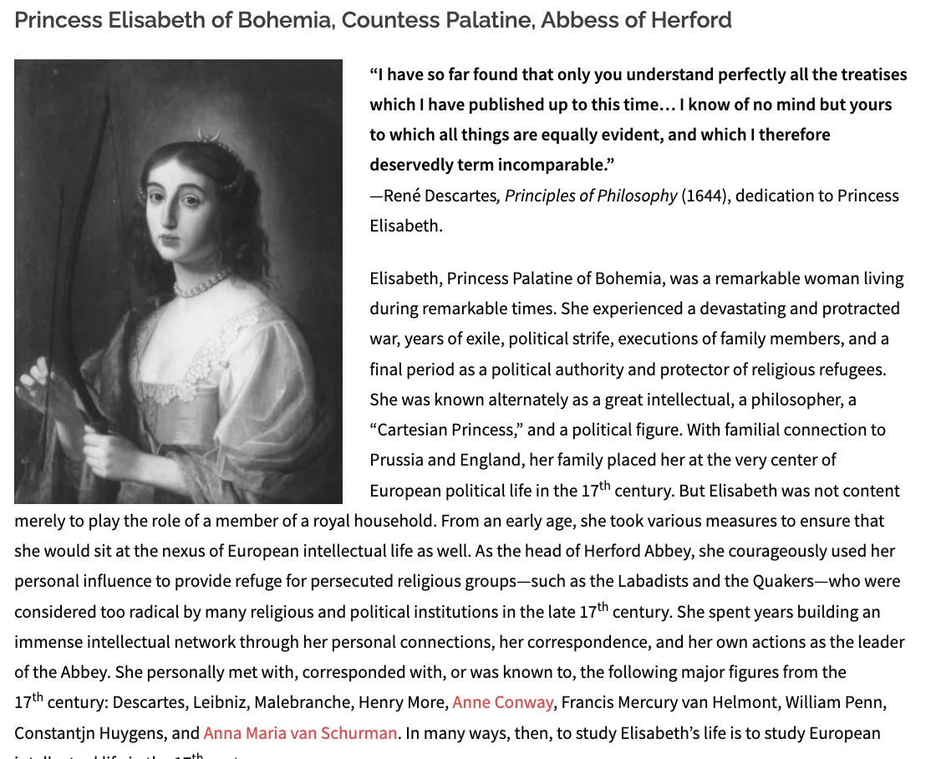
Notes:
hmmm what about Princess Elisabeth ?
she should have a ton of connections

Slide 16
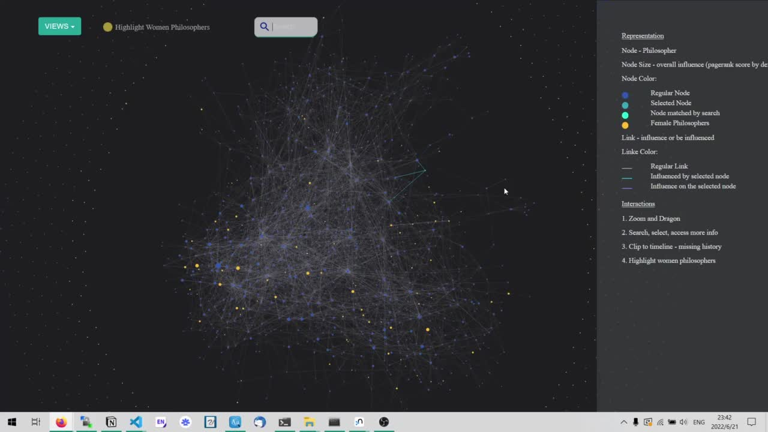
Notes:
Junyi...
Princess Elisabeth only has no connections

Slide 17
Vision
Actuality
Make A Visualization!
Developing A Workflow and Method
Notes:
Karen

Slide 18
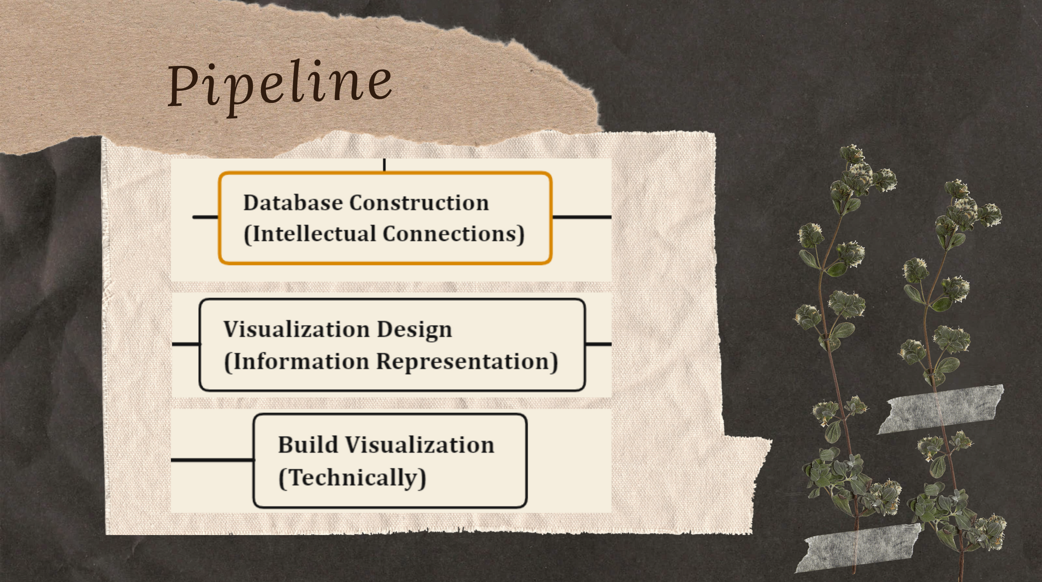
Notes:
Junyi

Slide 19





Data transformation sustainbale workflow
Json ->
Transform spreadsheets to json
Speadsheet
Graph Database
Network Vis
Design schema for relationships between philosophers
Be user-friendly for researchers to input data
Get insights from graph data
Make network visualizations
<- Json
Import Json files into neo4j, a graph database tool
Transform json back to spreadsheets
for researchers to input new data
Notes:
Junyi

Slide 20
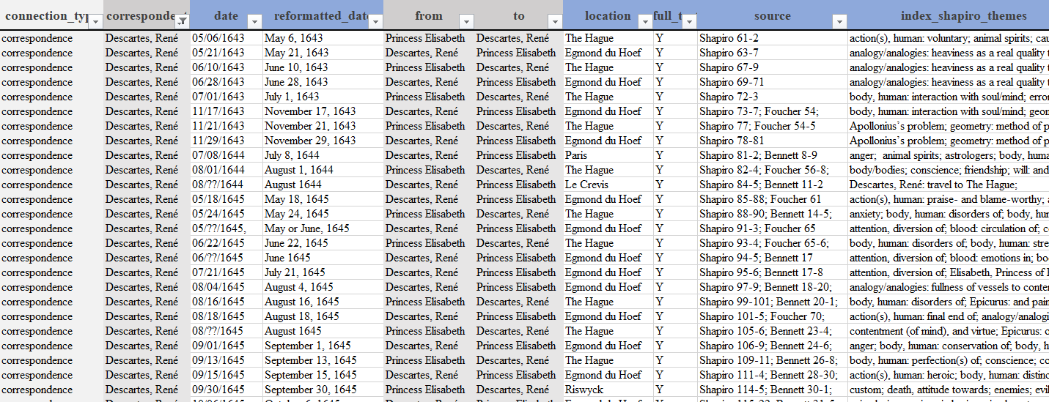

Step 1. Data Collection Template
Notes:
Karen

Slide 21
Hard Questions
Inclusion
Bias
What to keep?
What to show?
There is always bias
Missing Data
There is always going to be something missing
Sustainable
How can this work for Project Vox in the future?
Trust
How do we trust the data?
Data is falliable
Notes:
Oops ....
making philosophical texts, connections, ideas condensed into an excel spreadsheet is not as simple as it sounds

Slide 22
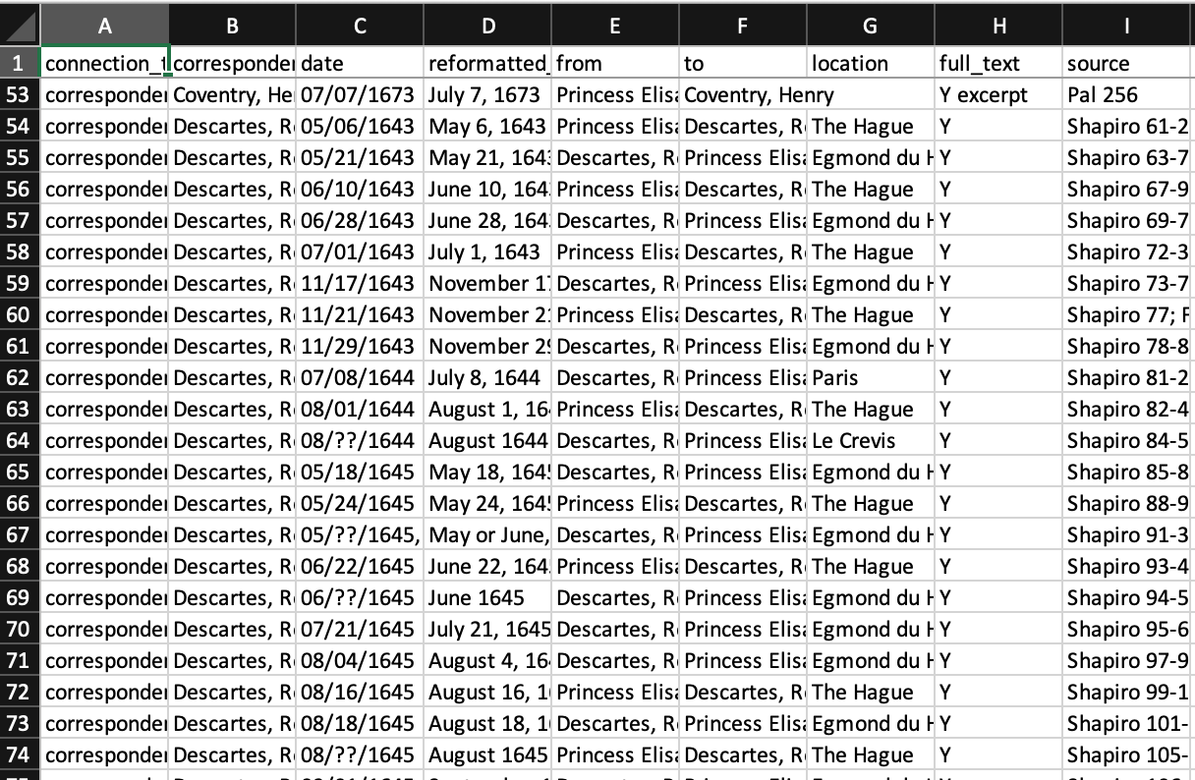
Step 2. Spreadsheet
(After Standardization)
Notes:
Junyi

Slide 23
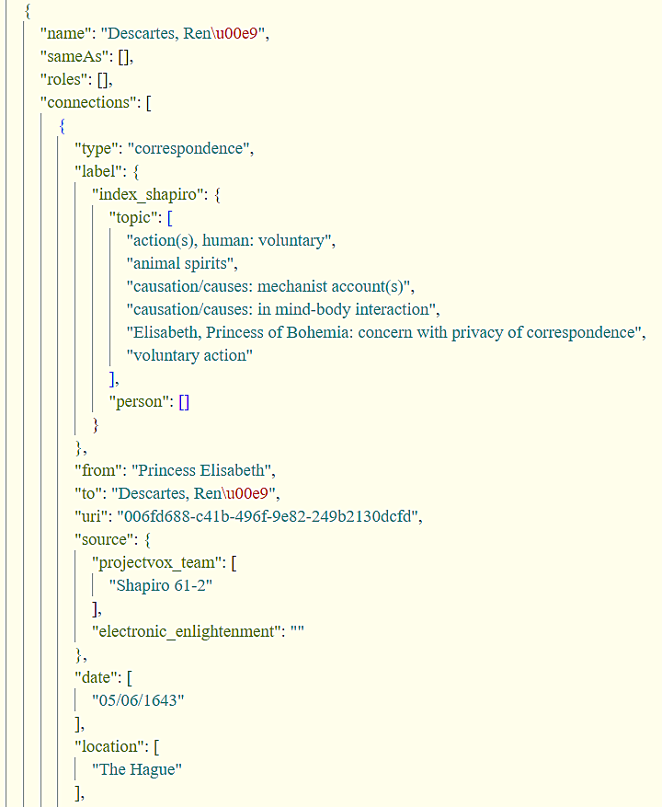

Step 3. Transform to Json
Notes:
Junyi

Slide 24
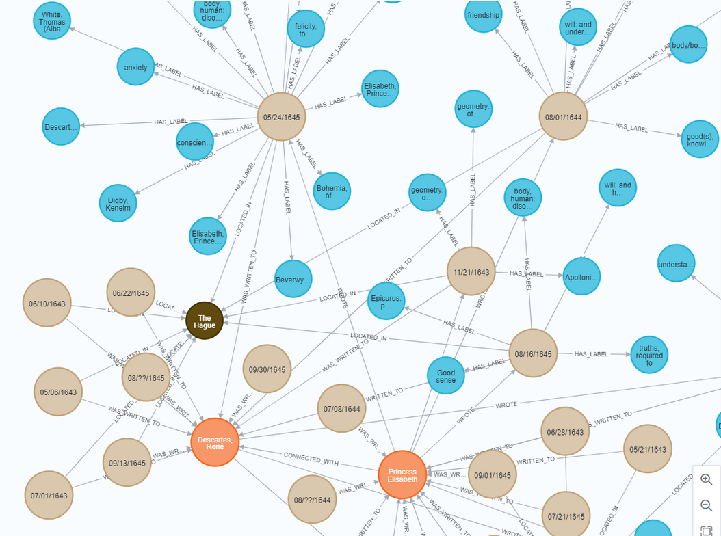
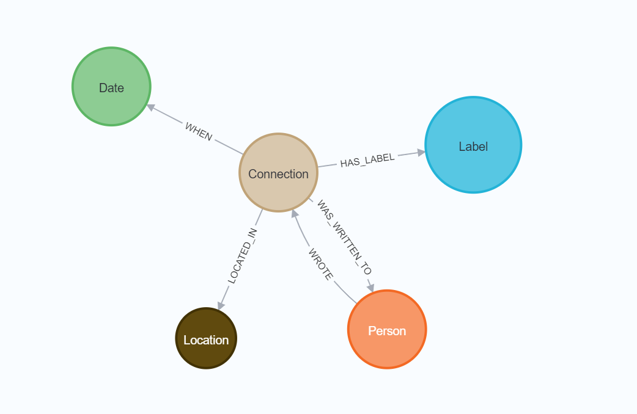
Step 4. Graph Database
Notes:
Karen: brief explanation
Ask Junyi:
why are we using a graph database?

Slide 25
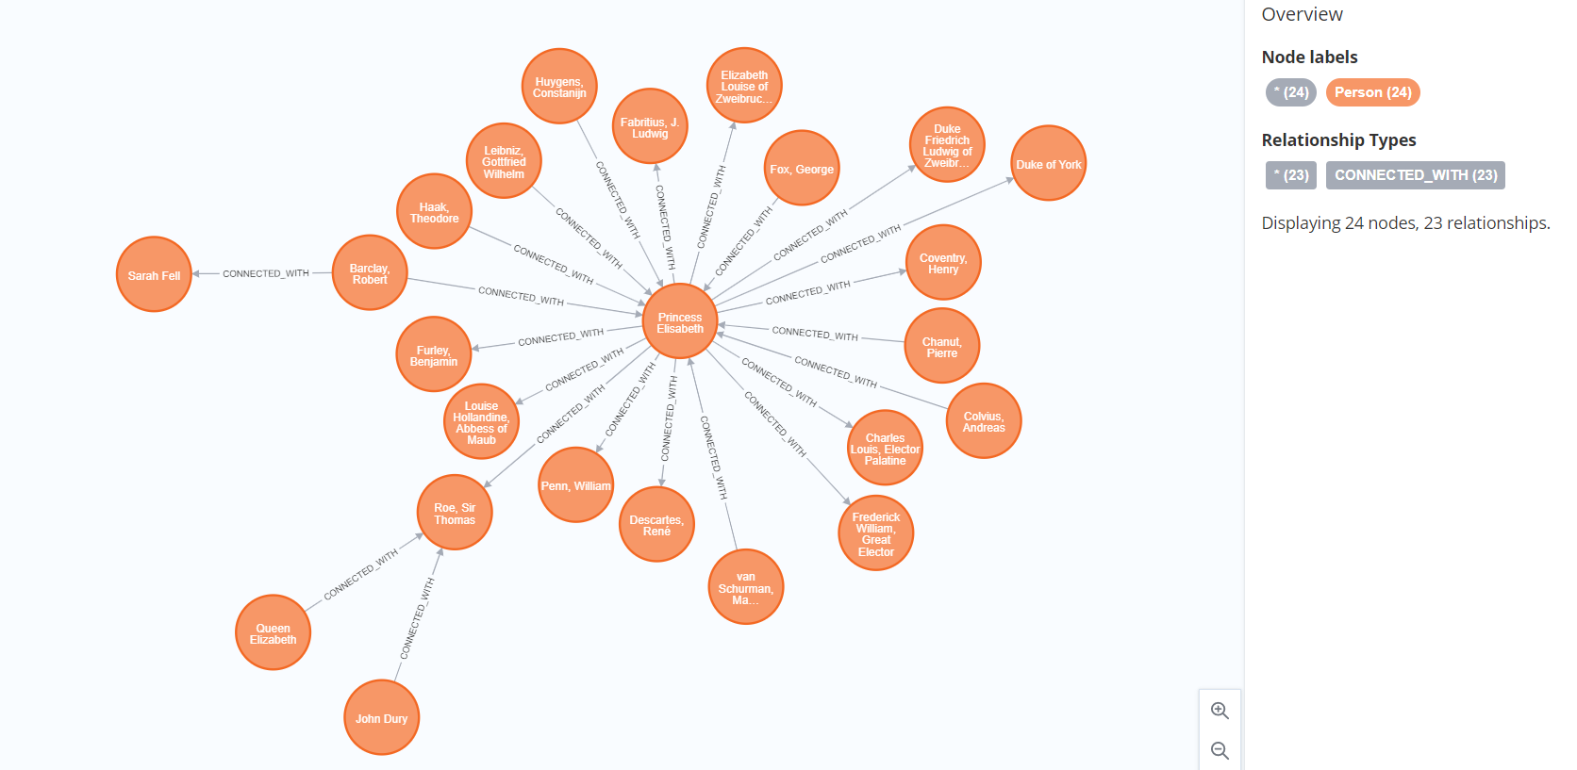
Interpersonal Connections
Notes:
Karen
Princess Elisabeth has connections !

Slide 26
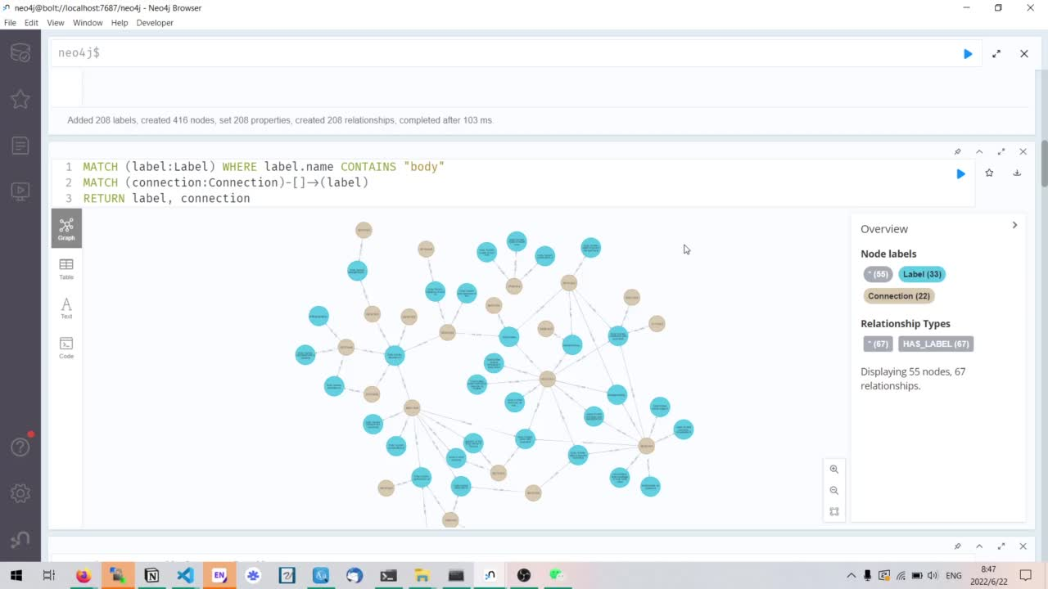
Intellectual Connections
Notes:
Junyi talks about body as video plays

Slide 27
Other Things
Storymap timelines
Develop Various Templates
Text Analysis (Topic Modeling, etc.)
Documentation (1) Blog Posts (2) Metadata Schema
Weekly Readings and Discussions
Notes:
Karen + Junyi

Slide 28
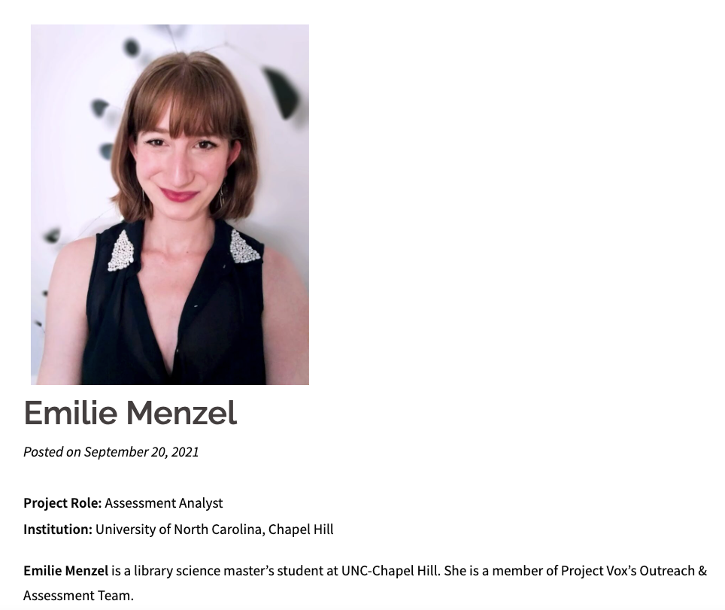
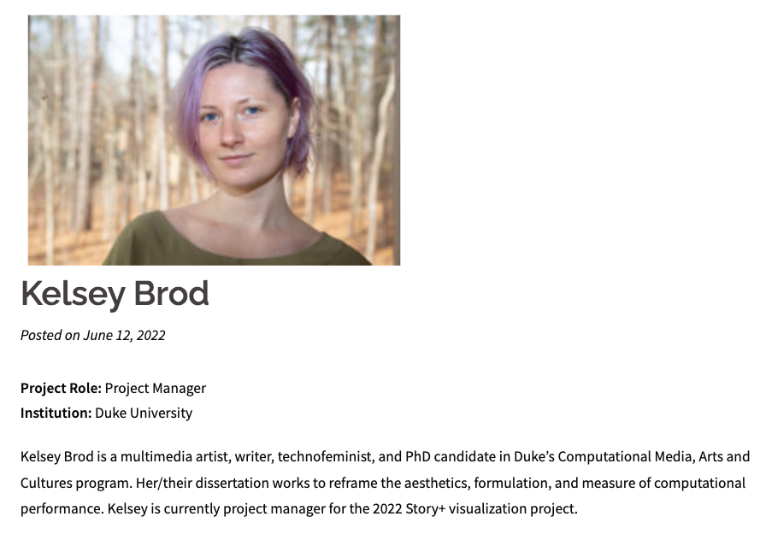
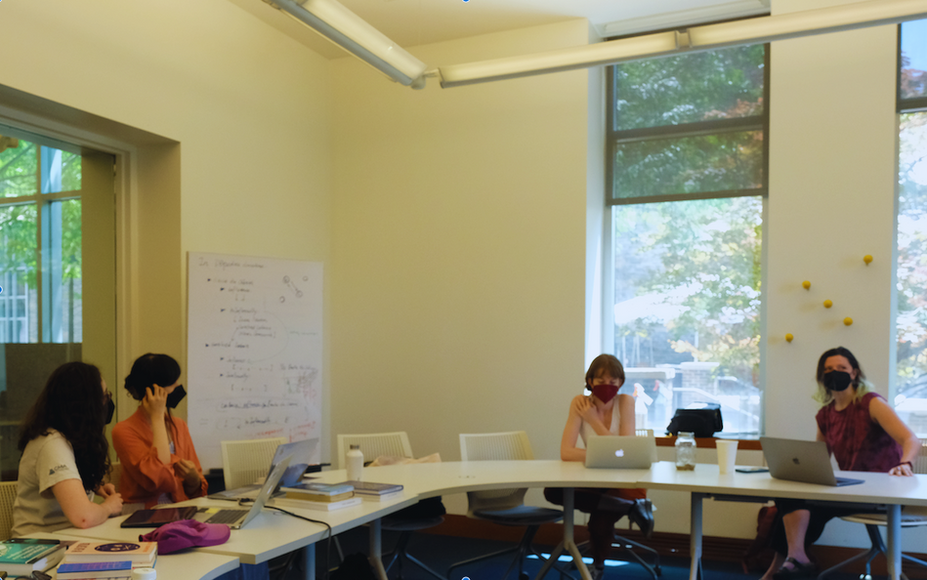
Our amazing Team
Notes:
Thank you Kelsey and Emilie!

Slide 29
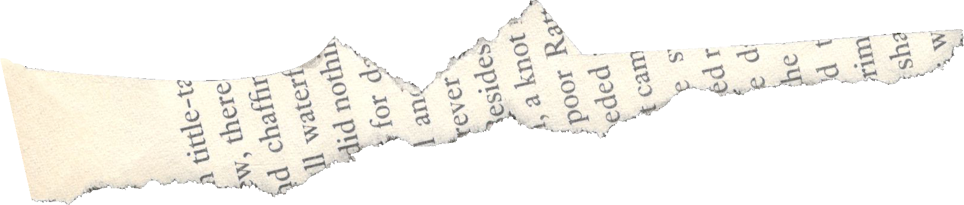

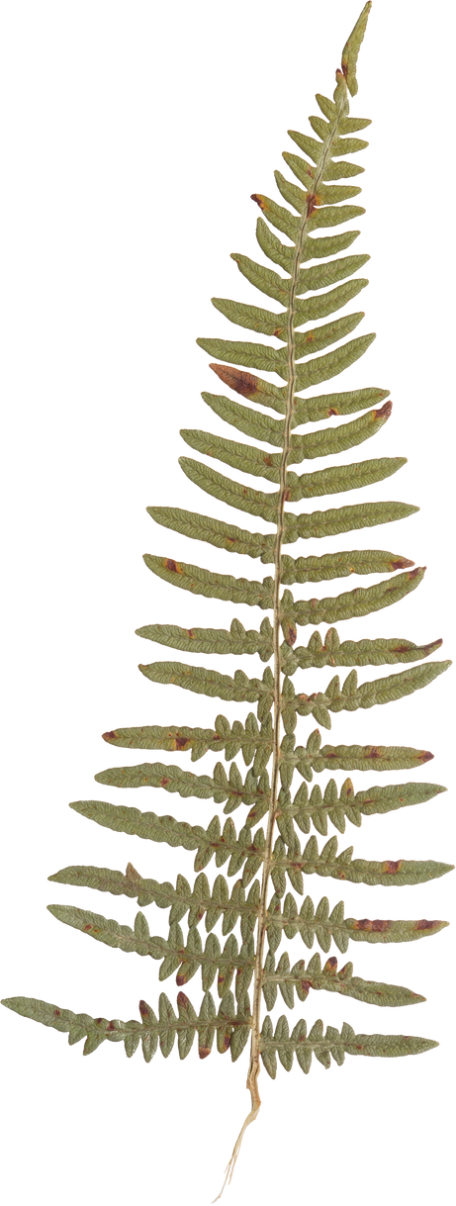

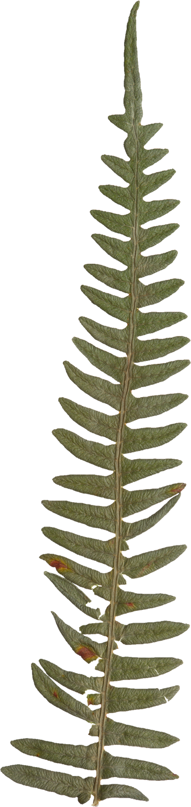
Any Questions?
Check out our blog posts and the Project Vox website for more info

Slide 30
Documentation

Slide 31
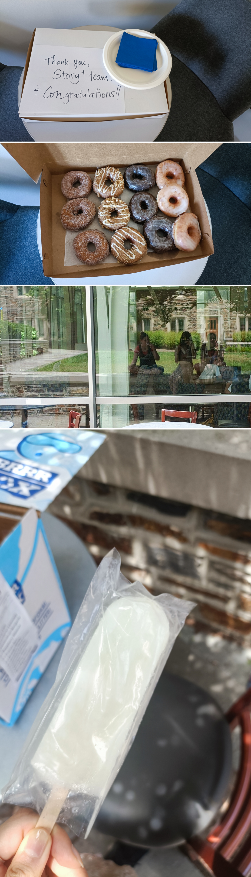
...of Happy Moments!

Slide 32
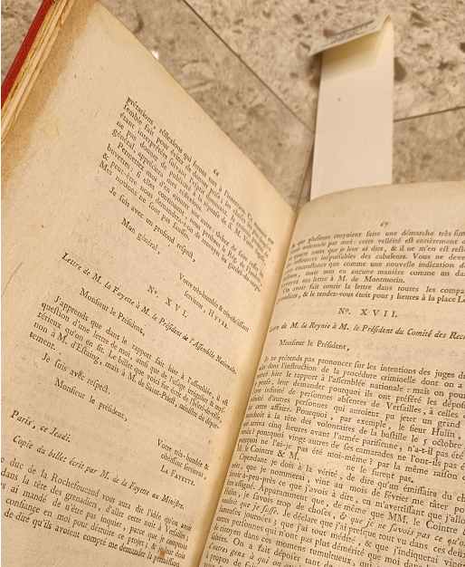
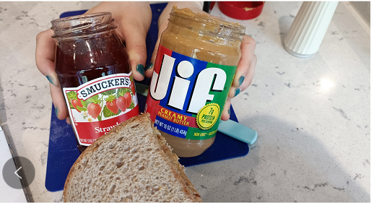
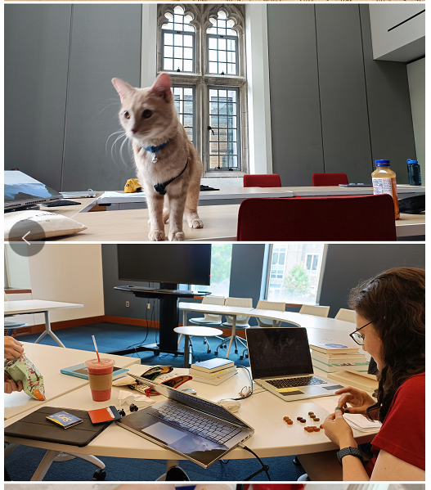


Slide 33
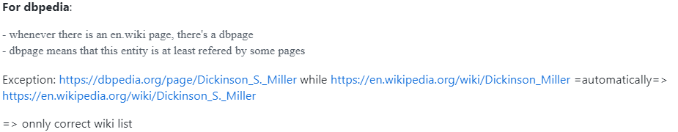
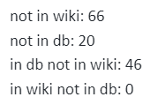
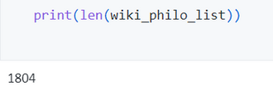
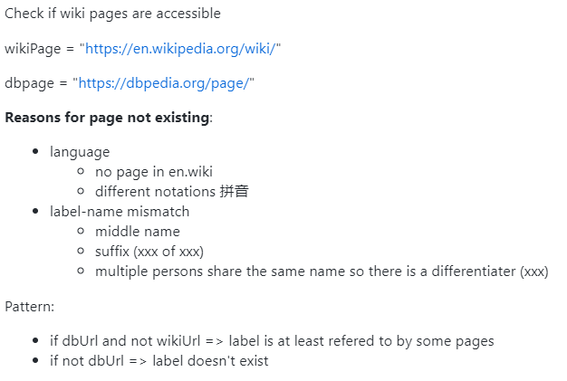
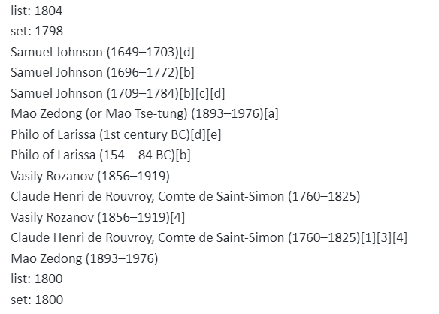
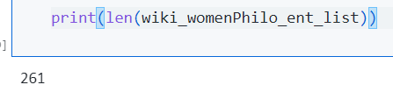
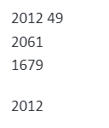
more
Subheading
212/261 women philosophers are not even included in the philosopher list!

Slide 34

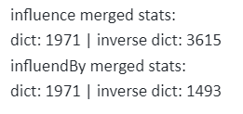

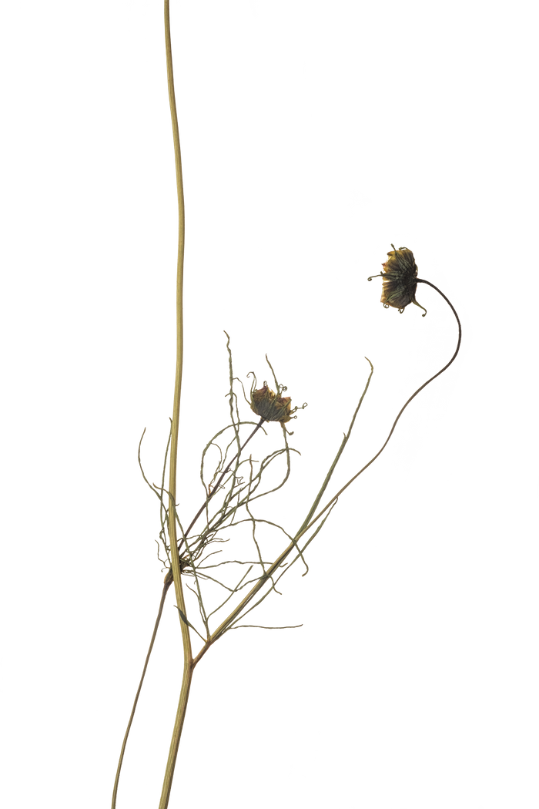




More Statstics
9908-9220) / 9908 = 6.9% | 688 in total
5640-4884)/5640 = 13.4% | 756 in total
(9908+5640-9220-4884)/(9908+5640) = 9.29%
1444 in total

Slide 35


